Slide 1

How linking changes the role of library data
Tom Baker, Dublin Core Metadata Initiative
SWIB11 – Semantic Web in Libraries
Hamburg, 29 November 2011

Slide 2

Library of Congress to replace MARC
2011-10-31. LC project to replace Machine-Readable Cataloging (MARC) format
  New bibliographic framework focused on Web environment
  Linked Data principles and mechanisms
  Resource Description Framework (RDF) as basic data model
RDF will “enable the integration of library data... on the Web for more expansive user access to information”
http://www.loc.gov/marc/transition/news/framework-103111.html

Slide 3
Digital Public Library of America
2011-11-21. First plenary for building a “large-scale digital public library”
  Make cultural and scientific record available to all
  David Ferriero, US Archivist: “that every object in the National Archives should be digitized and available worldwide”
  Carl Malamud: “If we can put a man on the moon, why can’t we launch the Library of Congress into cyberspace?”

Slide 4
“Manifesto for Linked Libraries (et al.)”
Stanford Linked Data Workshop final report
“Foment the development of a disruptive paradigm for knowledge representation”
  Library community to depart from ‘business as usual’
  “Structure data semantically”
  “Publish data on Web rather than preserving in dark”
  “Continuously improve Linked Data rather than waiting to publish ‘perfect’ data”
W3C Library Linked Data Incubator Group report

Slide 5
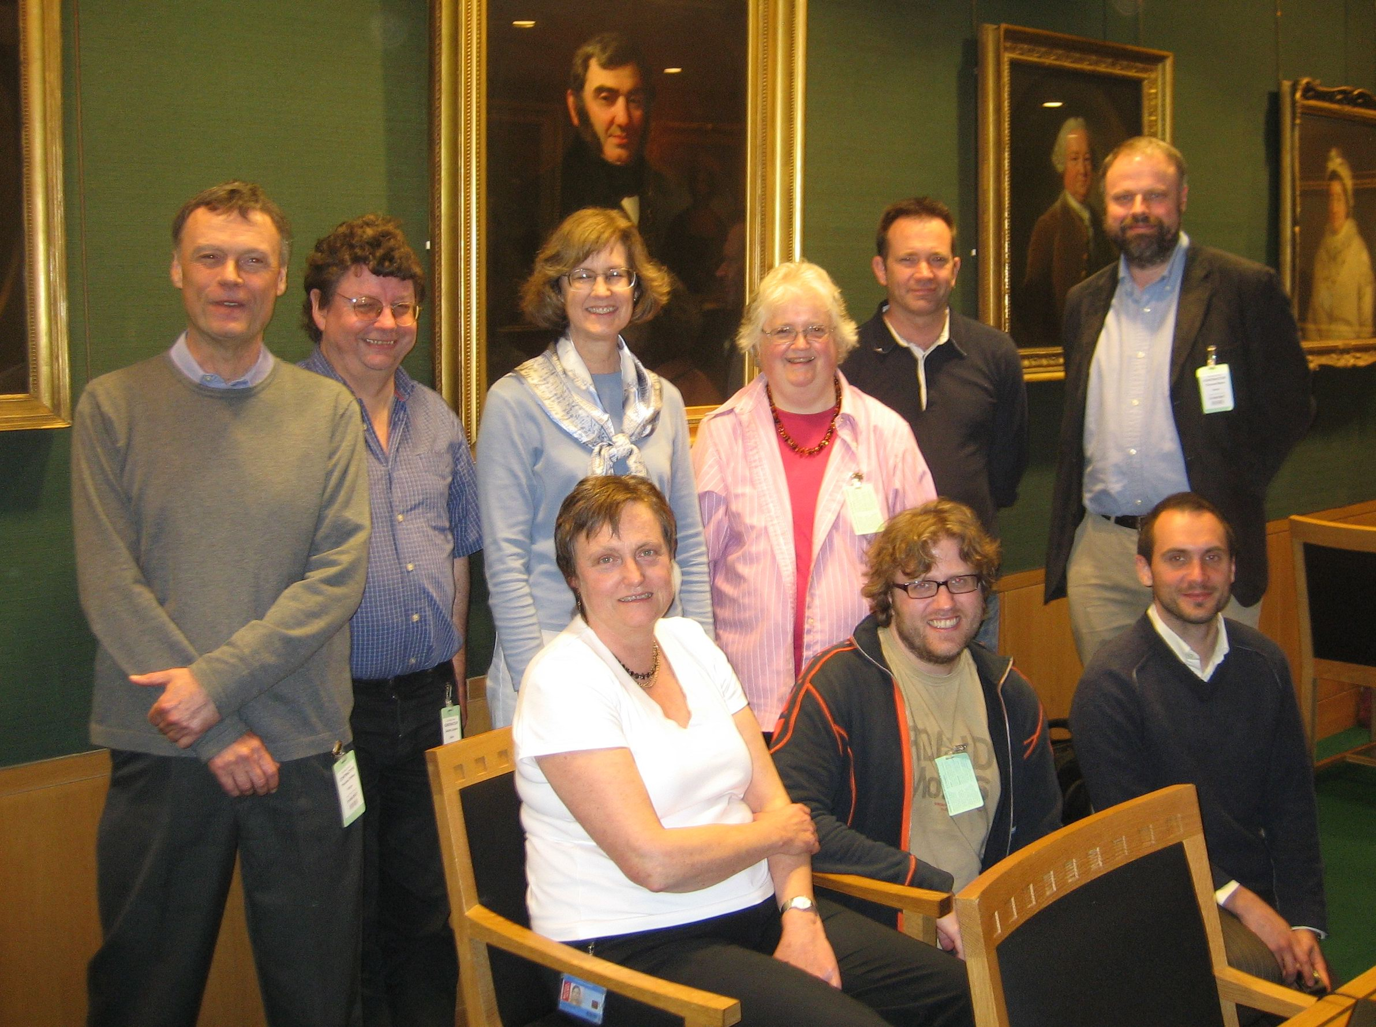
May 2007
RDA Data Model meeting

Slide 6
Joint position in 2007
RDA and DCMI communities should develop
  RDA Element Vocabulary
  Dublin Core-style Application Profile based on RDA, FRBR, and FRAD
  RDA Value Vocabularies using RDF and SKOS
Expected benefits
  Library community gets a metadata standard (RDA) compatible with Web Architecture and Semantic Web
  DCMI community gets an Application Profile for library data based on the DCMI Abstract Model and FRBR
  Wider uptake of high-quality RDA terms by the Semantic Web community
http://www.bl.uk/bibliographic/meeting.html

Slide 7
Effects of the London meeting
DCMI/RDA Task Group (2007)
  RDF property vocabularies for FRBR entities and for RDA elements, relationships, and roles
  Seventy controlled lists of terms
IFLA’s FRBR Namespaces Project (2007)
  To express Functional Requirements for Bibliographic Records (FRBR) in RDF
IFLA’s ISBD/XML Study Group
  To develop an RDF representation of International Standard Bibliographic Description
DCMI Bibliographic Metadata Task Group (2011)
LC project will consider DCMI Abstract Model (2011)

Slide 8
This talk
Dublin Core from Record Format to RDF Vocabulary
Packaging RDF Graphs in Record Formats
Constraining the Domain Model versus constraining the Description Set
Designing the Networked Catalog

Slide 9
Dublin Core from Record Format to RDF Vocabulary

Slide 10
“Dublin Core” as a record format
1995: Workshop in Dublin, Ohio
  Goal: simple metadata record for describing Web objects
  Name Dublin Core Metadata Element Set evokes MARC “data elements”
  2001: Format for OAI-PMH (Simple Dublin Core)
    XML formats for Qualified Dublin Core
  2011: Still largely associated in library world with a simple – simplistic – exchange format

Slide 11
“Dublin Core” as RDF vocabulary
1997. Organizers of RDF Working Group at DC workshop in Canberra
1999. First W3C Recommendation for RDF addresses Dublin Core requirements
  DCMI Metadata Terms published as RDF schemas
  DC elements declared as RDF properties
2006. Top-10 vocabulary in “Linked Data cloud”

Slide 12
RDF is a language (for data)
Words
Nouns and Verbs
Sentence structure
Paragraphs
Footnotes
Dictionaries
URIs and literal text
Classes and Properties
RDF Statements (triples)
RDF Graphs
URIs [Domain Name Service]
RDF Schemas
Generic grammar for languages of description
Functions as native language, second language, or pidgin.

Slide 13
From Record Elements to alignment with RDF
1995 | 1997 | 2001 | 2007 | RDF
Element | Element |  | Property | rdf:Property
 | Qualifier | Element Refinement | Property | (rdfs:sub PropertyOf)
 |  | Encoding Scheme | Syntax Encoding Scheme | rdfs: Datatype
 |  |  | Vocabulary Encoding Scheme | skos: Concept Scheme?
==
==
==
==

Slide 14
Packaging RDF Graphs in Record Formats

Slide 15
Application Profiles
2000. Customize Dublin Core for specific uses.
  Mix-and-match terms from different standards
  The obvious next step. Very successful idea.
Problems in practice
  Idea implemented, in incompatible ways, in HTML, XML, RDF...
  Confusion whether DC elements could be used with elements from IEEE Learning Object Metadata (implemented as XML format)

Slide 16
Harmonization via RDF
2001. How can DC and IEEE LOM interoperate?
  Interoperable: Records exchanged between applications and interpreted correctly
  Harmonized. Records based on different specs mapped to a common model and interpreted correctly
Recipe for harmonization: map to RDF
  Adopt a common formal-semantic model (today: RDF)
  Create mappings that faithfully translate the meanings of each

Slide 17
Rationale for an Abstract Model
2003. First-draft “abstract model for Dublin Core metadata records” (DCAM)
  Specify contents and components of metadata
  Basis for harmonization
  Usable with HTML, XML... implementation syntax
  Conformant with RDF, exportable as triples

Slide 18
Bridging two mindsets
Orientation to Record Formats
  Bounded sets of fields to be “filled in” with information
Orientation to Graphs
  Unbounded webs of information connected by statements

Slide 19
agris:CD2001000179
dct:subject
agrovoc:c_4416
dct:title
dct:creator
"Heuschrecken..."@de
"Peter, B."
:PB
foaf:name
Subject | Predicate | Object
agris:CD2001000179 | dct:subject | agrovoc:c_4416k
agris:CD2001000179 | dct:title | "Heuschrecken..."@de
agris:CD2001000179 | dct:creator | :PB
:PB | foaf:name | "Peter, B."

Slide 20











agris:CD2001000179
dct:subject
agrovoc:c_4416
dct:title
"Heuschrecken..."@de
dct:creator
:PB
:PB
"Peter, B."
foaf:name
Slots for URIs, literals, language tags, datatypes...

Slide 21









agris:CD2001000179
dct:subject
agrovoc:c_4416
dct:title
"Heuschrecken"
de
dct:creator
:PB
H
:PB
foaf:name
"Peter, B."
Components of a metadata record that can be validated.

Slide 22






Description Set
Description
Described Resource URI
Property URI
Value URI
Property URI
Value String
Lang
Property URI
Value ID
Description
H
Value ID
Property URI
Value String
Generalized Abstract Model of a metadata record.

Slide 23
Description Set
Description
Non-literal
Property URI
Value URI
Value String
Lang
Vocabulary Encoding Scheme URI
Literal
Value String
Lang
DCAM grouping constructs have no equivalent in RDF,
but may soon with standardization of Named Graphs.

Slide 24
Property URI
Described Resource URI
<?xml version="1.0" encoding="UTF-8" ?>
<rdf:RDF xmlns:rdf="http://www.w3.org/1999/02/22-rdf-syntax-ns#"
xmlns:dcterms="http://purl.org/dc/terms/"
xmlns:foaf="http://xmlns.com/foaf/0.1/" >
<rdf:Description rdf:about="http://agris.fao.org/resource/CH2001000179">
<dcterms:title>Heuschrecken brauchen ökologische Ausgleichsflächen</dcterms:title>
<dcterms:subject rdf:resource="http://aims.fao.org/aos/agrovoc/c_4416" />
<dcterms:creator rdf:nodeID="PB" />
</rdf:Description>
<rdf:Description rdf:nodeID="PB">
<foaf:name>Peter, B.</my:name>
</rdf:Description>
</rdf:RDF>
Value URI
Abstract Model
components embedded
in application syntaxes
Value String
Expressed as triples
Subject | Predicate | Object
agris:CD2001000179 | dct:subject | agrovoc:c_4416k
agris:CD2001000179 | dct:title | "Heuschrecken..."@de
agris:CD2001000179 | dct:creator | :PB
:PBS | foaf:name | "Peter, B."

Slide 25
Property URI
Described Resource URI
<?xml version="1.0" encoding="UTF-8" ?>
<dcds:descriptionSet
xmlns:dcds="http://purl.org/dc/xmlns/2008/09/01/dc-ds-xml/">
<dcds:description
dcds:resourceURI="http://agris.fao.org/resource/CH2001000179">
<dcds:statement dcds:propertyURI="http://purl.org/dc/terms/title">
<dcds:literalValueString>Heuschrecken brauchen ökologische Ausgleichsflächen</dcds:literalValueString>
</dcds:statement>
<dcds:statement dcds:propertyURI="http://purl.org/dc/terms/subject"
dcds:valueURI="http://aims.fao.org/aos/agrovoc/c_4416"> <!-- value URI -->
<!-- Reference to value using local identifier -->
<dcds:statement dcds:propertyURI="http://purl.org/dc/terms/creator”
dcds:valueRef="PB" />
</dcds:description>
<!-- Description of value using local identifier -->
<dcds:description dcds:resourceId="PB">
<dcds:statement dcds:propertyURI="http://xmlns.com/foaf/0.1/name">
<dcds:literalValueString>Peter, B.</dcds:literalValueString>
</dcds:statement>
</dcds:description>
</dcds:descriptionSet>
Value URI
Value String
Expressed as triples
Subject | Predicate | Object
agris:CD2001000179 | dct:subject | agrovoc:c_4416k
agris:CD2001000179 | dct:title | "Heuschrecken..."@de
agris:CD2001000179 | dct:creator | :PB
:PBS | foaf:name | "Peter, B."

Slide 26
Templates for Description Sets
Constraints on Templates
Description Set [template]
Description [template]
Statement [template]
Property [constraint]
<http://purl.org/dc/terms/subject>
VocabularyEncodingSchemeURI [constraint]
<http://aims.fao.org/aos/agrovoc>
Statement [template]
Property [constraint]
<http://purl.org/dc/terms/title>
MinOccurs [constraint]
1
MaxOccurs [constraint]
1
Statement [template]
Property [constraint]
<http://purl.org/dc/terms/creator>
Description [template]
Resource Class [constraint]
<http://xmlns.com/foaf/0.1/Person>
Statement [template]
Property [constraint]
<http://xmlns.com/foaf/0.1/name>
“Records using this Description Set Profile…”
  describe a Resource,
  with exactly one [DC] Title,
  the [DC] Subject of which is taken from AGROVOC,
  which has [DC] Creators.
[DC] Creators
  are members of the FOAF class “Person”, and
  have [FOAF] Names.

Slide 27
Expressing ISBD in RDF
Element set and vocabularies expressed in RDF
DCAM-based Application Profile in development
  Models ISBD record
  Uses (and constrains) ISBD properties
    Are they Mandatory? Repeatable?
  Specifies aggregated statements, with sub-elements and punctuation

Slide 28
Expressing ISBD in RDF
Intended uses
  Parsing ISBD records into triples
  Checking integrity of ISBD records by identifying missing elements or sequencing errors
ISBD properties available for other uses, e.g., in British National Bibliography

Slide 29
Description Set Profiles for ISBD
<!-- Area 0 is mandatory and non-repeatable-->
<StatementTemplate
ID="hasContentFormAndMediaTypeArea"
minOccurs="1"
maxOccurs="1"
type="nonliteral">
<Property>
http://iflastandards.info/ns/isbd/elements/P1158
</Property>
<!-- Area 0 is an aggregated statement with SES -->
<NonLiteralConstraint
descriptionTemplateRef=
"DThasContentFormAndMediaTypeArea">
<ValueStringConstraint>
<SyntaxEncodingScheme>
http://iflastandards.info/ns/isbd/elements/C2003
</SyntaxEncodingScheme>
</ValueStringConstraint>
</NonLiteralConstraint>
</StatementTemplate>
“Records using this Description Set Profile…”
  have “Content Form and Media Type” area (“Area 0”),
  which is mandatory and non-repeatable
“Area 0”
  Aggregated statement
  Follows specific Syntax Encoding Scheme (datatype)

Slide 30
Constraining the Domain Model versus
Constraining the Description Set

Slide 31





Application Profile
Usage
Guidelines
annotates
Functional
Requirements
Domain
Model
Description
Set Profile
Record
Format
Community
Domain Model
Metadata
Vocabularies
DCMI Abstract
Model (DCAM)
DCAM Syntax
Guidelines
Domain Standards
RDF Schema
RDF
Foundation Standards
= "builds on"

Slide 32


Application Profile
Usage
Guidelines
annotates
Functional
Requirements
Domain
Model
Description
Set Profile
Record
Format
Community
Domain Model
Metadata
Vocabularies
DCMI Abstract
Model (DCAM)
DCAM Syntax
Guidelines
Domain Standards
RDF Schema
RDF
Foundation Standards
= "builds on"

Slide 33
Domain Models versus
Description Set Profiles
Domain Models
Description Set Profiles
About “Reality”
  Cartoon-like universe focused on “things of interest”
May use community models
  Heaney model of collections, FRBR...
About data in Records
  “Slots” for URIs, strings, language and datatype tags
Uses underlying vocabularies
  Constrains them for specific purposes
Domain
Model
Description
Set Profile
“Reality”-facing
Data-facing
Community
Domain Model
Metadata
Vocabularies

Slide 34
IFLA’s Domain Model for FRBR in RDF
Functional Requirements for Bibliographic Records
  groups descriptive attributes in 4 component sets
WEMI: Work, Expression, Manifestation, Item
  Modeled by IFLA as four disjoint classes
  This means:
    Of interest are four types of “things in the world”
    If a resource belongs to one class, it may not also belong to another
  Strong dependencies cause existence of WEMI entities to be inferred
    e.g., describing “language of text” implies Expression

Slide 35
“Strong” FRBR ontology criticized
Disjoint WEMI classes criticized as “rigid”
  Problem when merging FRBR-based with non-FRBR-based data
  “Class collisions”: Is Book comparable to Manifestation or Work?
People see different conceptual universes
  Experts may see “colorized film” as a distinct Work
  More pragmatically, existing database environments may impose different distinctions

Slide 36
Workarounds and “re-visionings”
Alternative proposals
  Jakob Voss: Simplified Ontology (SOBR): Document, Edition, Item – all non-disjoint
Super-classes and super-properties
  rda:adaptedAsARadioScript as sub-property of
  rda:adaptedAs
Workarounds
  Ross Singer: “commonThing” properties
    existence of common FRBR entity is simply inferred

Slide 37
Workarounds and “re-visionings”
“Revisioning” of cataloging theory
  Ron Murray and Barbara Tillett
  WEMI entities as “groups of statements that occupy different levels of abstraction”
  Sub-graphs of a description with complementary views
    “Work” sub-graph = description of resource “viewed as a Work”
  Suggests WEMI entities not as Classes, but as RDF Named Graphs

Slide 38
Minimal Ontological Commitment
Good ontology design (Thomas Gruber)
  Key: promote consistent use of vocabulary
  Require minimal commitment sufficient to support intended knowledge-sharing activities
  Make as few claims as possible about the world being modeled
  Allow freedom to specialize and instantiate the ontology as needed
  Specify the weakest theory, allowing the most models
  Principle explicitly followed for designing SKOS, implicitly for Dublin Core

Slide 39
Where to constrain?
Domain Models
Description Set Profiles
Strongly constrained models
  Discourage broad uptake by imposing specific world views
  People view reality differently
Minimally constrained
  Few claims about “reality”
  Users specialize as needed
  Optimal for re-use in “open world” of Linked Data
Arbitrarily strong constraints
  Underlying vocabularies – only locally constrained – remain globally compatible
  Data validation for quality control and consistency of data
  Optimal for closed-world, controlled environments, e.g., library cataloging depts
Straightforward mapping to triples

Slide 40
Designing the
Networked Catalog

Slide 41
“Flat” Catalog Card
Source: Gordon Dunsire, “The semantic web and expert metadata” (2009)
http://strathprints.strath.ac.uk/16458/1/strathprints016458.pdf

Slide 42
“Relational”
Bibliographic description
Name authority
Author:
Name:
Lee, T. B.
Title:
Cataloguing has a future
Biography:
Content type:
Spoken word
...
Carrier type:
Audio disc
Subject authority
Subject:
Term:
Metadata
Provenance:
Donated by the author
Definition:
...
Source: Dunsire, 2009

Slide 43
FRBR-ized Record
Name authority
Name:
Lee, T. B.
Biography:
Work
...
Author:
Subject authority
Subject:
Term:
Metadata
Expression
Definition:
Content type:
Spoken word
...
Manifestation
Title:
Cataloguing has a future
Carrier type:
Audio disc
Item
Provenance:
Donated by the author
Source: Dunsire, 2009

Slide 44
Catalog Card becomes extinct, replaced by Networked Description
Work
Name authority
Author:
Name:
Lee, T. B.
Subject:
Subject authority
Expression
Content type:
Term:
Metadata
Manifestation
RDA content type
Title:
Term:
Spoken word
Carrier type:
RDA carrier type
Item
Term:
Audio disc
Donor:
Amazon/Publisher
Title:
Cataloguing has a future
Source: Dunsire, 2009

Slide 45
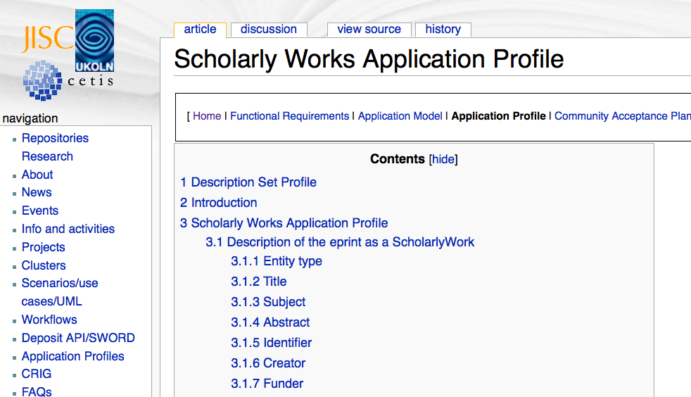
How a FRBRized record might look
[2006]
http://www.ukoln.ac.uk/repositories/digirep/index/Scholarly_Works_Application_Profile

Slide 46
SWAP Domain Model
AffiliatedInstitution
isSupervisedBy
isFundedBy
ScholarlyWork
isCreatedBy
Agent
isEditedBy
isExpressedAs
Expression
isPublishedBy
isManifestedAs
Manifestation
isAvailableAs
Copy
Application Domain Model

Slide 47
Based on FRBR
AffiliatedInstitution
isSupervisedBy
isFundedBy
Work
ScholarlyWork
isCreatedBy
Agent
isEditedBy
Expression
Expression
isPublishedBy
Manifestation
Manifestation
Item
Copy
Community Domain Model

Slide 48
What are these entities?
Agent
name
type of agent
date of birth
mailbox
homepage
identifier
ScholarlyWork
title
subject
abstract
identifier
Expression
title
date available
status
version number
language
genre / type
copyright holder
bibliographic citation
identifier
Manifestation
format
date modified
Copy
date available
access rights
licence
identifier
...when created and exchanged in quality-controlled environments?
...when expressed as triples and published as Linked Data?

Slide 49
Designing the Networked Catalog
New: Library data must play well as Linked Data
  Vocabularies that allow freedom to specialize and constrain for local needs
Traditional: Data that is quality-tested and consistent
  Implies data-oriented Description Set Profile approach
Solution will require joint effort of Library and Semantic Web communities

Slide 50
tom@tombaker.org
50

Slide 51
W3C Library Linked Data Incubator Group
2011-11-25. Final report recommends
  That library leaders identify datasets for early exposure as Linked Data
  That library standards bodies participate in Semantic Web standardization and develop design patterns tailored to library data
  That systems designers create user services based on Linked Data capabilities
  That librarians apply experience in curation to long-term preservation of Linked Data vocabularies and datasets

