Slide 1
Highs and Lows of Library Linked Data
Semantic Web in Bibliotheken 2011
Hamburg, Germany
29th November 2011
Adrian Stevenson
UKOLN, University of Bath, UK (until end Dec 2011)
Mimas, Libraries and Archives Team, University of Manchester, UK (from Jan 2012)

Slide 2
LOCAH and Linking Lives Projects
Linked Open Copac and Archives Hub
Funded by #JiscEXPO 2/10 ‘Expose’ call
1 year project. Started August 2010
Partners & Consultants:
UKOLN, Mimas, Eduserv, Talis, OCLC, Ed Summers
http://blogs.ukoln.ac.uk/locah/
Linking Lives
JISC funded for ‘Mimas Enhancements’
11 month project. Started Sept 2011
http://archiveshub.ac.uk/linkinglives/

Slide 3
Archives Hub and Copac
UK National Data Services based at Mimas
Copac provides access to the merged library catalogues of libraries throughout the UK, including all national libraries
http://copac.ac.uk
Archives Hub is an aggregation of archival descriptions from archive repositories across the UK
http://archiveshub.ac.uk
Notes:
Copac a union catalogue
Both successful JISC services running for many years now
Locah is a research project – will have to see if go into service with LD interface

Slide 4
LOCAH Outputs
Expose Archives Hub & Copac data as Linked Data
Create a prototype visualisation
Report on opportunities and barriers

Slide 5
How do we expose the Linked Data?
Model our ‘things’ into RDF
Transform the existing data into RDF/XML
Enhance the data
Load the RDF/XML into a triple store
Create Linked Data Views
Document the process, opportunities and barriers on LOCAH Blog

Slide 6
Modelling ‘things’ into RDF
Copac data in ‘Metadata Object Description Schema’ MODS XML form
http://www.loc.gov/standards/mods/
Take a step back from the data format
What is MODS document “saying” about “things”?
What questions do we want to answer about those “things”?
Notes:
Encoded Archival Description is an XML standard for encoding archival finding aids
The Object Description Schema (MODS) is an XML-based bibliographic description schema
MODS - Metadata Object Description Schema (MODS) is a schema for a bibliographic element set that may be used for a variety of purposes, and particularly for library applications.
EAD -
Things” include concepts and abstractions as well as material objects
We want location – archives physical things so location important
Also wanted event data, partly steered by the visualisation prototype
Also ‘extent’ data – number of boxes

Slide 7
Aggregated Data
Copac MODS record = an aggregated book record
e.g. ‘Bleak House’ held at 10 different libraries
Copac ‘merges’ the descriptions from 8 of them
2 are not consistent with the rest, so they remain as stand-alone descriptions
End result: have 3 records for ‘Bleak House’
Not talking about ‘a book’

Slide 8
URI Patterns
Need to decide on patterns for URIs we generate
Following guidance from W3C ‘Cool URIs for the Semantic Web’ and UK Cabinet Office ‘Designing URI Sets for the UK Public Sector’
http://data.archiveshub.ac.uk/id/findingaid/gb1086skinner ‘thing’ URI
redirects to …
http://data.archiveshub.ac.uk/doc/findingaid/gb1086skinner document URI
http://www.w3.org/TR/cooluris/ http://www.cabinetoffice.gov.uk/resource-library/designing-uri-sets-uk-public-sector
Notes:
303 and Content Neg from ‘Cool URIs for the Semantic Web’

Slide 9
Vocabularies
Using existing RDF vocabularies:
DC, SKOS, FOAF, BIBO, WGS84 Geo, Lexvo, ORE, LODE, Event and Time Ontologies
Define additional RDF terms where required,
copac:BibiographicResource
copac:Creator
It can be hard to know where to look for vocabs and ontologies
Notes:
Open Data Commons Public Domain Dedication
Creative Commons CC0 license

Slide 10
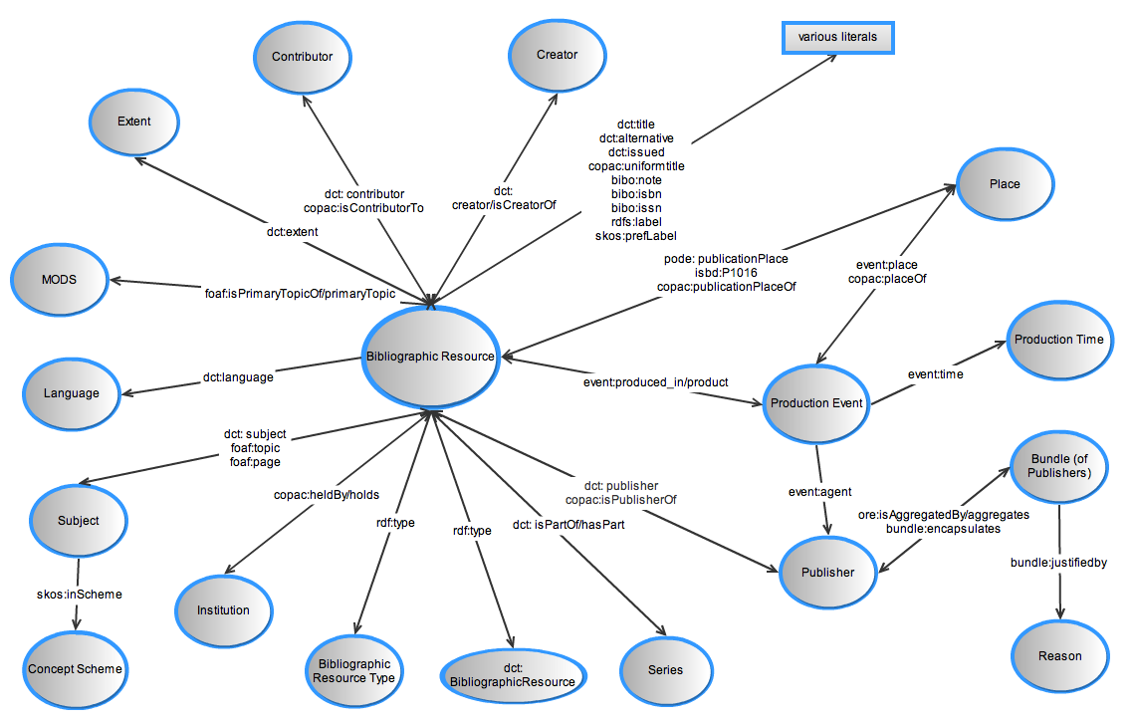
Copac Model

Slide 11
Transforming into RDF/XML
Transform EAD and MODS to RDF/XML based on our models
Copac: created in-house Java transformation program
Hub: XSLT Stylesheet
Load RDF/XML into a triple store

Slide 12
We’re Linking Data!
If something is identified, it can be linked to
We take items from our datasets and link them to items from other datasets
BBC
Copac
VIAF
DBPedia
GeoNames
Archives Hub
Notes:
In hypertext web sites it is considered generally rather bad etiquette not to link to related external material.
The value of your own information is very much a function of what it links to, as well as the inherent value of the information within the web page. So it is also in the Semantic Web.
Remember, this is about machines linking – machines need identifiers; humans generally know when something is a place or when it is a person.
BBC + DBPedia + GeoNames + Archives Hub + Copac + VIAF = the Web as an exploratory space
Users very interested in related materials acc to Terry Catapano at SAA 2011. LD can really help with this.

Slide 13
Enhancing our data
Already have some links:
Time - reference.data.gov.uk URIs
Location - UK Postcodes URIs and Ordnance Survey URIs
Names - Virtual International Authority File
VIAF matches and links widely-used authority files - http://viaf.org/
Names - DBPedia
Also looking at:
Subjects - Library Congress Subject Headings and DBPedia

Slide 14
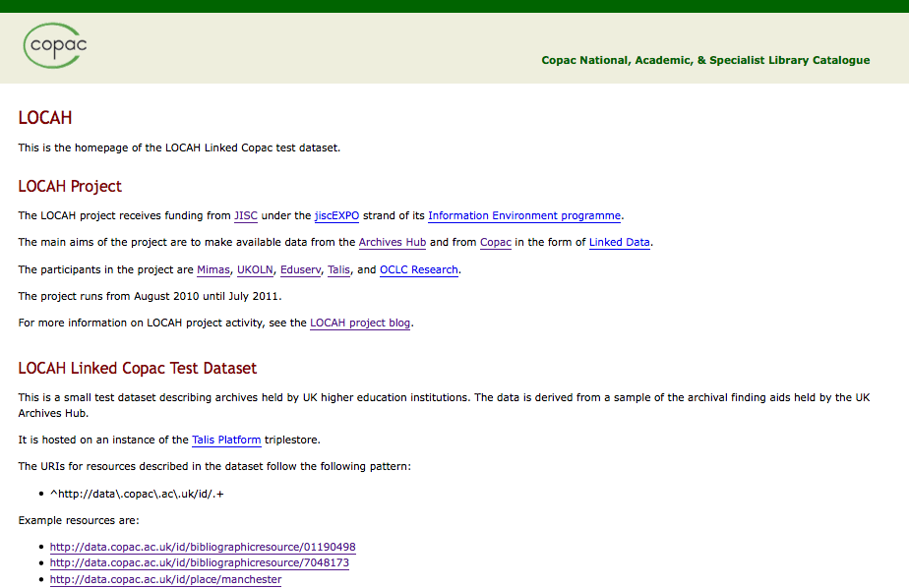
http://data.copac.ac.uk/ (to be released very soon!)

Slide 15
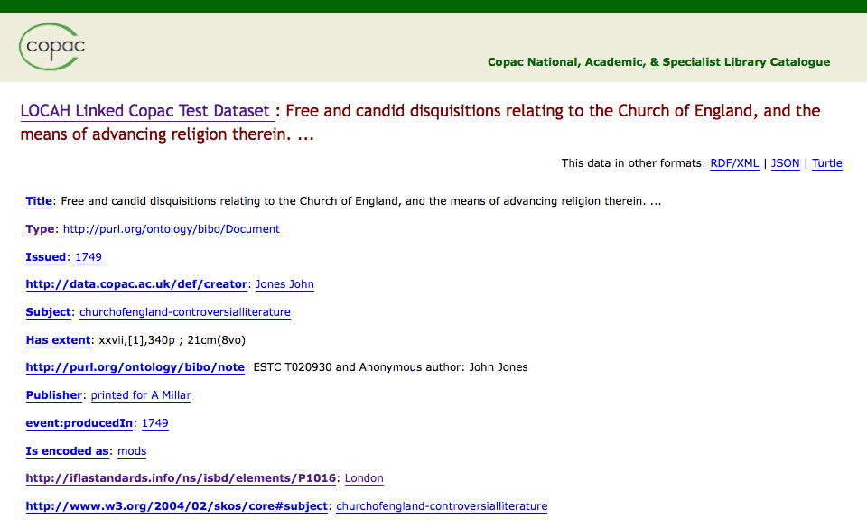

Slide 16
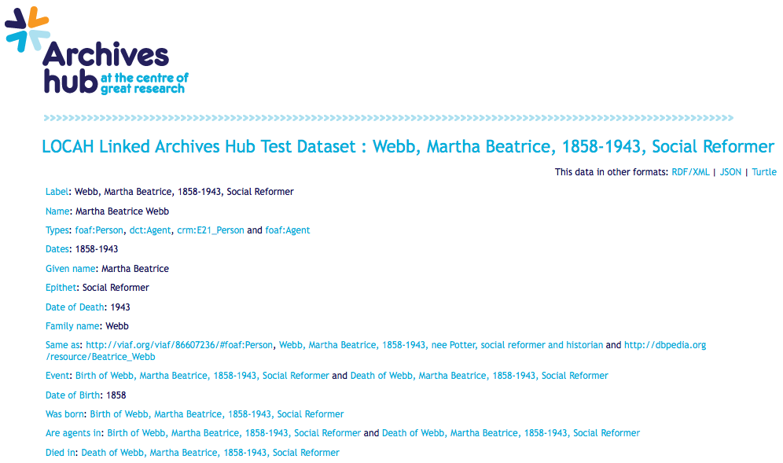
http://data.archiveshub.ac.uk/id/person/nra/webbmarthabeatrice1858-1943socialreformer
Notes:
Note that it is machine readable interface as well as the human interface
Currently have a few hundred in Locah. There are 25,000 EAD records on the Hub srevice. We’re Intending to put about 2,000 up for Linking Lives Project.

Slide 17
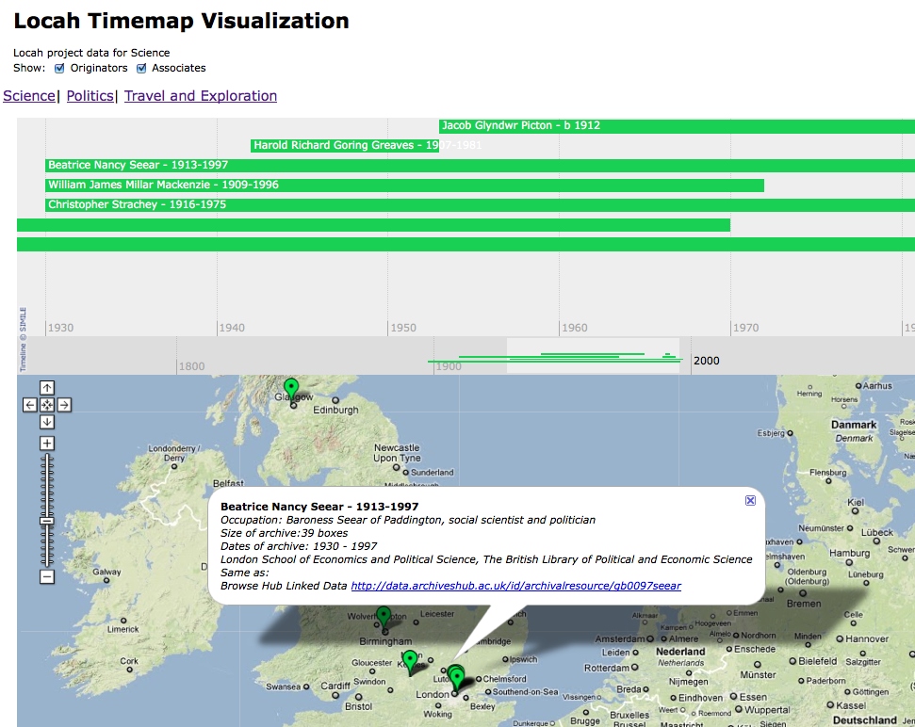
Visualisation Prototype
Using Timemap –
Googlemaps and Simile
http://code.google.com/p/timemap/
Early stages with this
Will give location and ‘extent’ of archive.
Will link through to Archives Hub

Slide 18
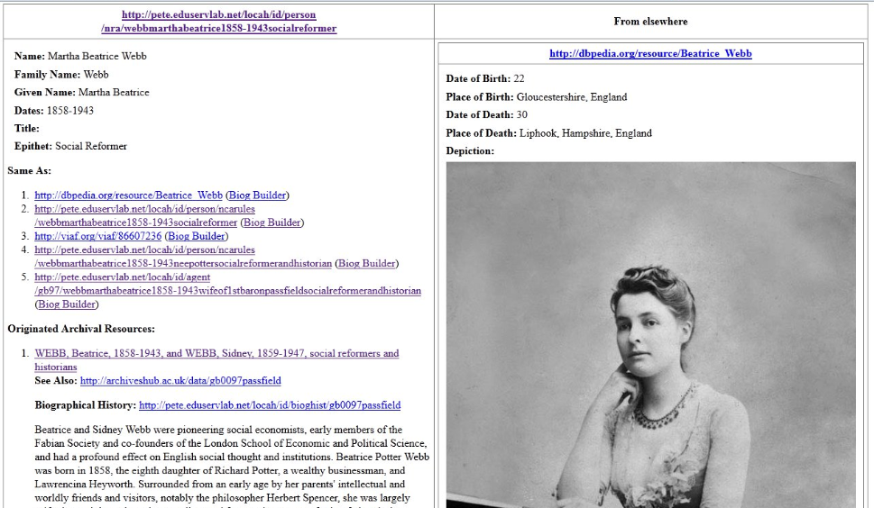
Linking Lives Project
http://archiveshub.ac.uk/linkinglives/
Notes:
More aggregation

Slide 19
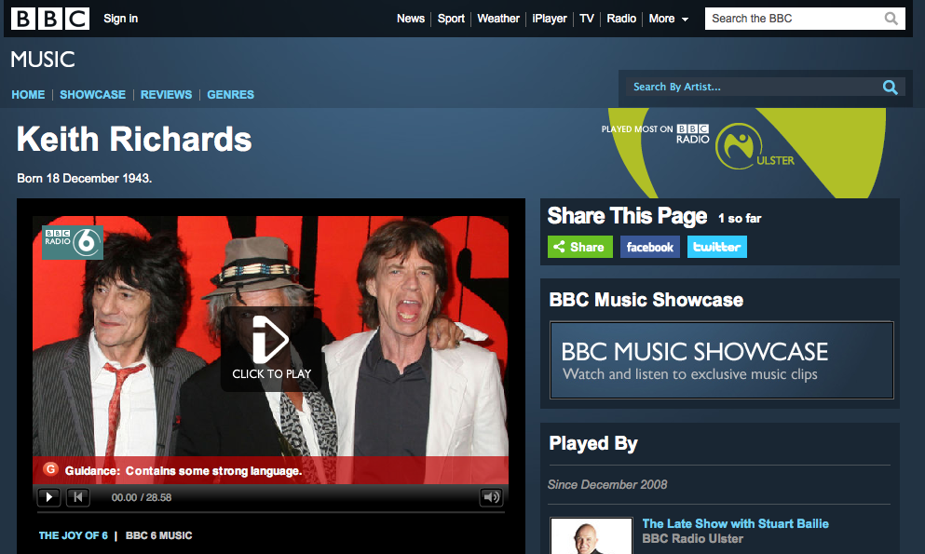
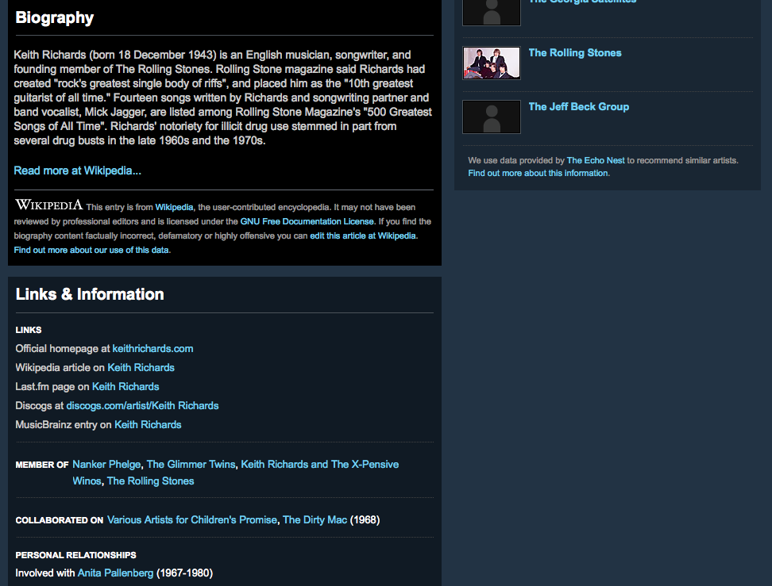
BBC Music
http://www.bbc.co.uk/music/artists/f0ed72a3-ae8f-4cf7-b51d-2696a2330230

Slide 20
Highs of Linked Data
API based mashups work against a fixed set of data sources
Hand crafted by humans
Don’t integrate well
Linked Data promises an unbound global data space
Easy dataset integration
Generic ‘mesh-up’ tools
Notes:
Data can be integrated from many diff sources
Users very interested in related materials acc to Terry Catapano at SAA 2011. LD can really help with this.

Slide 21
Lows of Linked Data?

Slide 22
Data Modelling
Steep learning curve
RDF terminology “confusing”
Lack of archival examples
Complexity
Archival description is hierarchical and multi-level
‘Dirty’ Data
Notes:
Steep learning curve:
- RDF Linked Data modeling terminology
- Lack of archive domain examples – though you now have LOCAH!
- Certain level of expertise needed
Dirty Data
- Joe Bloggs and others’ rather than just a name, or where the access points do not have rules or a source associated with them.
- Extent data highly variable
Complexity
- “lower level” units interpreted in context of the higher levels of description
- Arguably “incomplete” without the contextual data.
Relations are asserted, e.g. member-of/component-of
But there is no requirement or expectation that data consumers will follow the links describing the relations

Slide 23
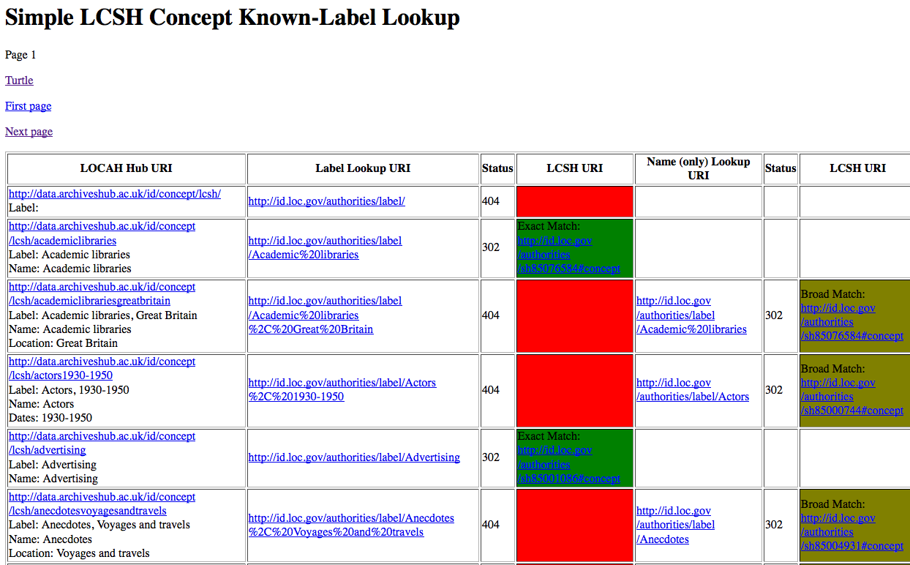
Linking Subjects

Slide 24
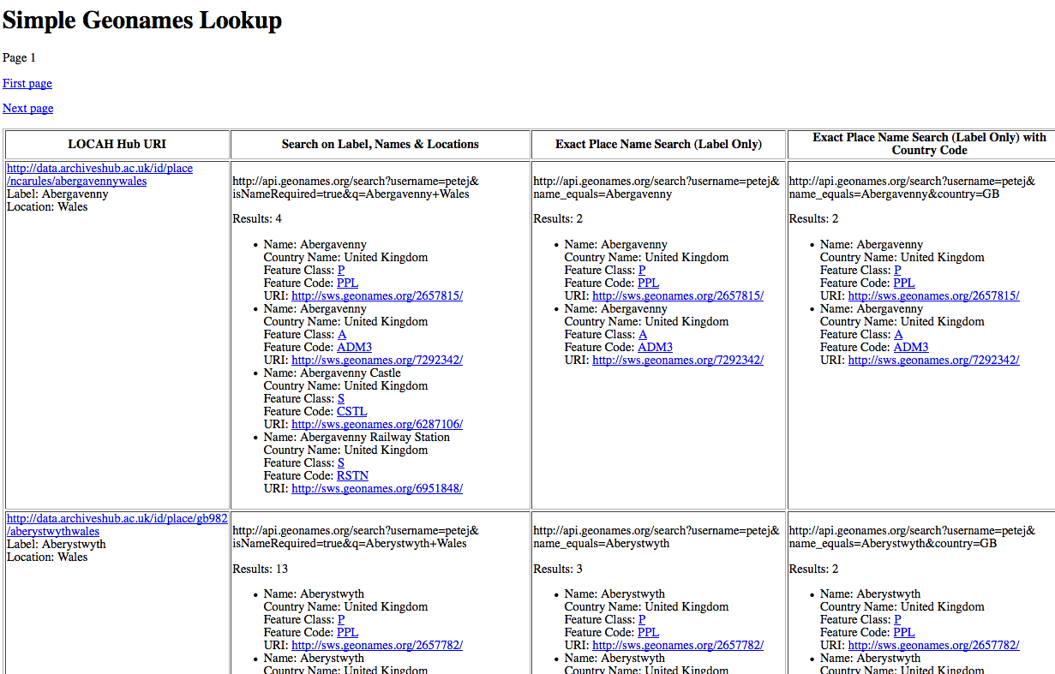
Linking Places

Slide 25
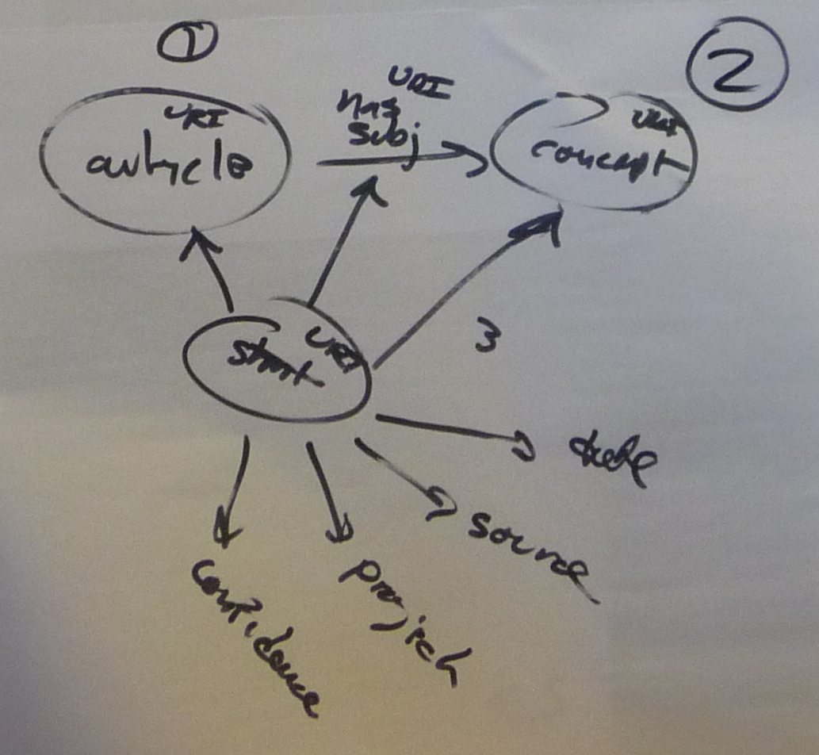
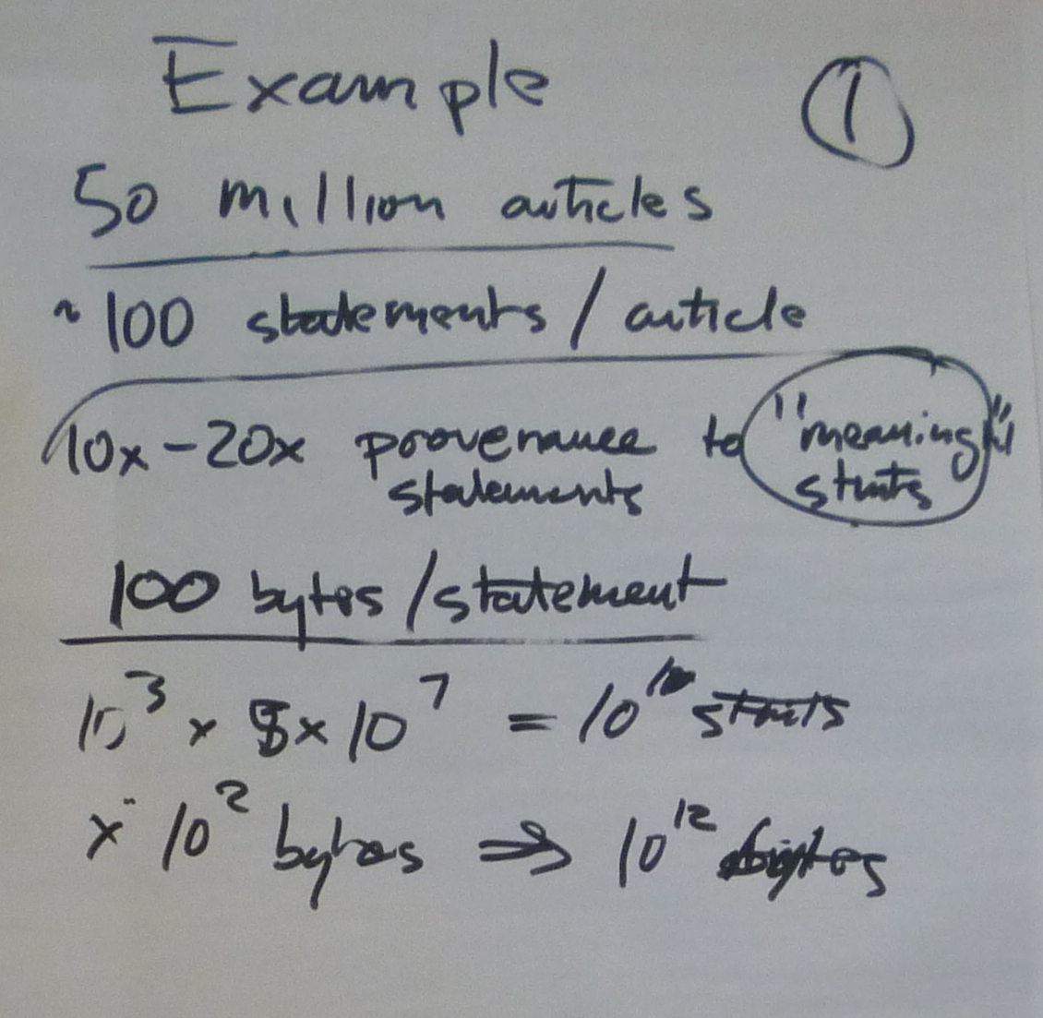
Scalability / Provenance
Same issue with attribution
Solutions: Named graphs? Quads?
Best Practice
Example by Bradley Allen, Elsevier at
LOD LAM Summit, SF, USA, June 2011
Notes:
Ex

Slide 26
Licensing
Ownership of data often not clear
Difficult to track attribution and provenance
CC0 for Archives Hub and Copac data test sets

Slide 27
Sustainability
Can you rely on data sources long-term?
Ed Summers at the Library of Congress created http://lcsh.info
Linked Data interface for LOC subject headings
People started using it

Slide 28
Library of Congress Subject Headings

Slide 29
Linked Data the Future for Libraries?
Enables ‘straightforward’ integration of wide variety of data sources
Library data can ‘work harder’
New channels into your data
Researchers are more likely to discover sources
‘Hidden' collections become of the Web

Slide 31
Attribution and CC License
Sections of this presentation adapted from materials created by other members of the LOCAH & Linking Lives Projects
This presentation available under creative commons Non Commercial-Share Alike:
http://creativecommons.org/licenses/by-nc/2.0/uk/

