Slide 1
Notes:
I am a cell biologist with 45 years of undergraduate teaching experience. Five years ago, I gave up laboratory work entirely, and swapped making videos of lymphocytes killing virally-infected cells to concentrate on research data management, metadata models and ontologies. My wife thinks I’m crazy.
The benefits of publishing research data openly for re-use are becoming increasingly understood, and I will not rehearse those points.
Rather, I want to talk to you this afternoon about why researchers at present don’t manage their research data well, and how we can improve the situation, drawing from the activities and experience of my own research group in the Department of Zoology in Oxford.
So, I want to exemplify tools and systems that permit local data management, enable data storage in repositories, assist in the creation of rich metadata to accompany and describe datasets, and enable data citation.
All the work I will be describing has been made possible through JISC funding of five projects on which I am Principle Investigator.
Have you noticed how you never do anything until it becomes the FIRST priority – worthy tasks that are always only second or third priority NEVER get done! It’s often that way with data management.

Slide 2
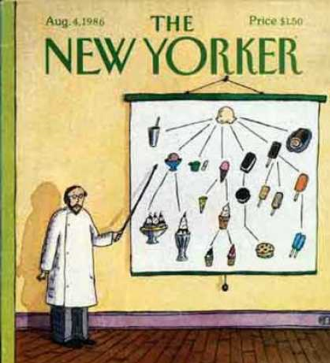
Notes:
It was in 2002 that I first came to the University of Manchester, met Robert Stevens, and first heard the “O” word.
Before that time, I had been a respectable scientist in a world class biological research department. Since then, I have been doomed to an existence dominated by predicates, axioms and disjoint classes, where crazed philosophers battle card-carrying pragmatists, and am shunned by my Zoology Department colleagues as some weird alien who is no longer part of the real world of research endeavour.
Thank you, Manchester. This seminar is my revenge!

Slide 3
Outline of my presentation
Exemplar semantic enhancements to a research paper
The Semantic Publishing and Referencing (SPAR) Ontologies
Uses of CiTO, the Citation Typing Ontology
The SPAR ontologies
Encoding bibliographic records using SPAR
Citations in context
The Open Citation Corpus – bibliographic references as open linked data
Open Research Reports – open access structured summaries of infectious
disease journal articles
Notes:
The publication of research papers and data, and the citation of others' preceding work, are central social activities in the commmunication of scientific research results
However, these activities have not been widely explored by ontologists, and a comprehensive suite of public, open, and complementary ontologies for published entities and bibliographic citations has not been available
In this talk, I will discuss how semantics can enhance these publication and citation activities

Slide 4
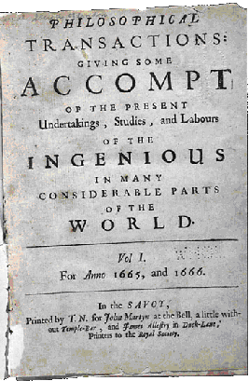
Research publishing has changed very little in 346 years
We still have a linear narrative, with references
The norm is to publish the online journal article as a static file mimicking the printed page
This is totally antithetical to the spirit of the Web, and ignores its great potential
Rather, we need lively journal content
Semantic mark-up of text
Interactive figures
Links between papers and datasets
Actionable numerical data

Slide 5
What do I mean by semantic publishing?
The use of simple Web and Semantic Web technologies
to enhance the meaning of on-line published research articles
to provide access to published data in actionable form
to link articles with their cited references and other information sources
to link articles to the research datasets that underpin them
to provide machine-readable summaries of an article’s content
to facilitate integration of semantically related scientific information from heterogeneous distributed resources
so that data, information and knowledge can more easily be found, extracted, combined and reused

Slide 6
Examplar semantic enhancements
Exemplar semantic enhancements to a research article published in PLoS Neglected Tropical Diseases
Enhanced article available at:
http://dx.doi.org/10.1371/journal.pntd.0000228.x001
That work is described in:
Shotton D, Portwin K, Klyne G, Miles A (2009).
Adventures in semantic publishing: exemplar semantic enhancement of a research article.
PLoS Computational Biology 5: e1000361. http://dx.doi.org/10.1371/journal.pcbi.1000361

Slide 7
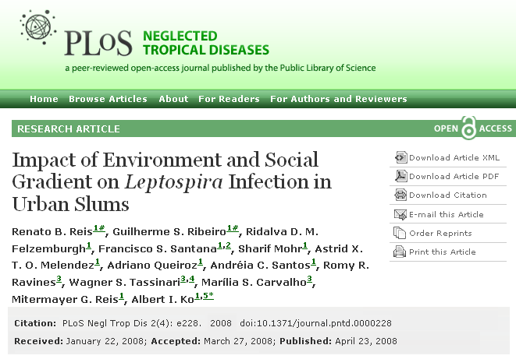
The article we chose to semantically ‘enliven’

Slide 8
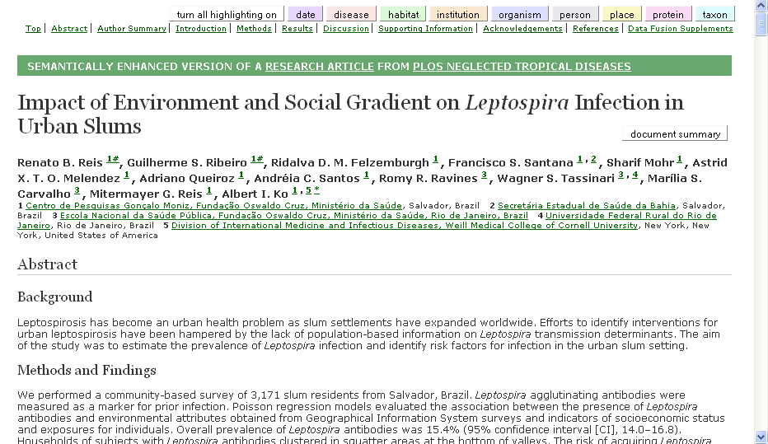
The enhanced paper by Reis et al. (2008)
http://dx.doi.org/10.1371/journal.pntd.0000228.x001

Slide 9
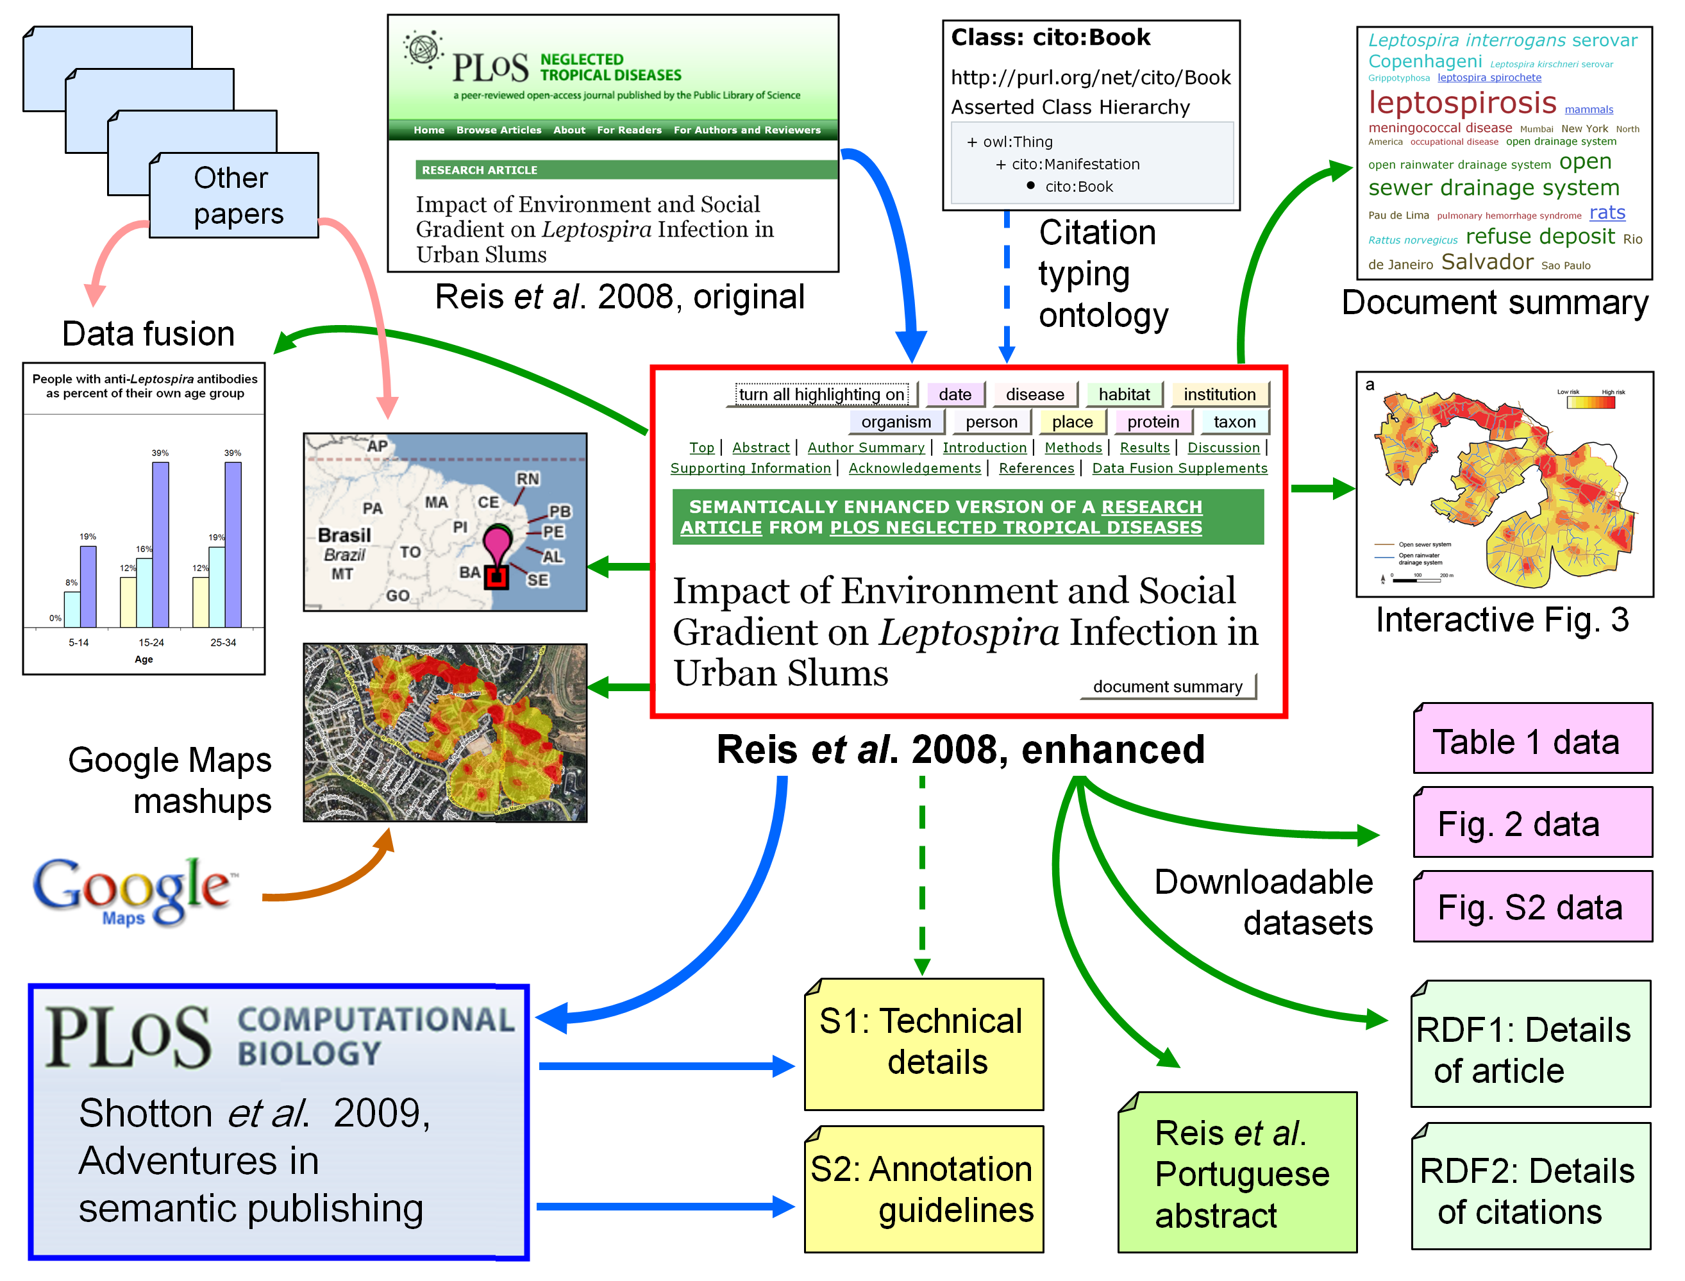

Slide 10
Our semantic enhancements to the Reis et al. paper
Better integration of the paper into the Web
Provision of hyperlinks to relevant Web sites
Live DOI links to full text of cited papers
Machine-readable metadata and reference files (RDF N3 and RDFa)
Additions to the paper
The datasets in the table and figures downloadable in actionable form
Semantic mark-up of terms in the text, with links to authorities
Enhanced Portuguese Abstract; Re-orderable reference list
Interactive figures, and the Supporting Claims Tooltip (exemplars)
Analysis of the content of the paper
Document summarization, including tag cloud and study summary
Citation frequency analysis and citation typing; marked-up references
Data fusion (mashup) services
Geo-temporal mashups with Google Maps
Integration with relevant disease incidence data in other publications

Slide 11
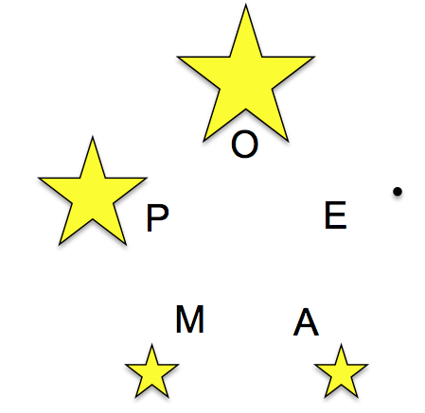
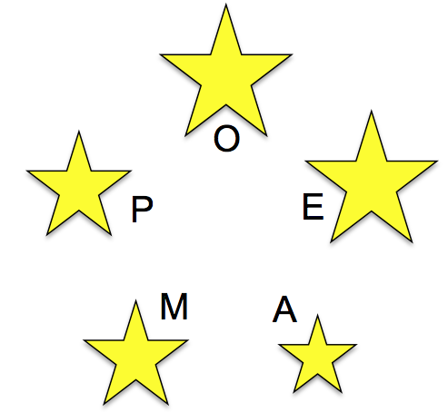
The Five Stars of Online Journal Articles
Shotton D (2011). The Five Stars of Online Journal Articles – an article evaluation framework. Preprint available at Nature Preceedings - http://precedings.nature.com/
Available datasets
0 No published data
1 Figures and tables available for download
2 Article data downloadable in actionable form
3 Underlying datasets available
4 Data available to peer-reviewers
e.g. Reis et al. (2008) PLoS Neglected Tropical Diseases 2: e228
before and after semantic enhancement
http://dx.doi.org/10.1371/journal.pntd.0000228.x001

Slide 12
The Force11 White Paper
Available at the Force11 Web site: http://www.force11.org/

Slide 13
The importance of citations and CiTO, the Citation Typing Ontology

Slide 14
What is a citation?
The performative act of citing a previously published work as being of relevance to the current work, made by including a reference in the paper’s reference list
Why are reference lists important?
A reference list is a work of scholarship by an author
Reference lists are integral components of the scholarly record
Why are citations important?
Citations unify the whole world of scholarship into a giant citation network
Sir Isaac Newton:
"If I have seen a little further, it is by standing on the shoulders of Giants"
How is the present situation imperfect?
Citations are scattered through the literature, so are difficult to study together
Often hidden behind subscription firewalls of commercial companies

Slide 15
Our semantic enhancements to the Reis et al. paper
Better integration of the paper into the Web
Provision of hyperlinks to relevant Web sites
Live DOI links to full text of cited papers
Machine-readable metadata and reference files (RDF N3 and RDFa)
Additions to the paper
The datasets in the table and figures downloadable in actionable form
Semantic mark-up of terms in the text, with links to authorities
Enhanced Portuguese Abstract; Re-orderable reference list
Interactive figures, and the Supporting Claims Tooltip (exemplars)
Analysis of the content of the paper
Document summarization, including tag cloud and study summary
Citation frequency analysis and citation typing; marked-up references
Data fusion (mashup) services
Geo-temporal mashups with Google Maps
Integration with relevant disease incidence data in other publications

Slide 16
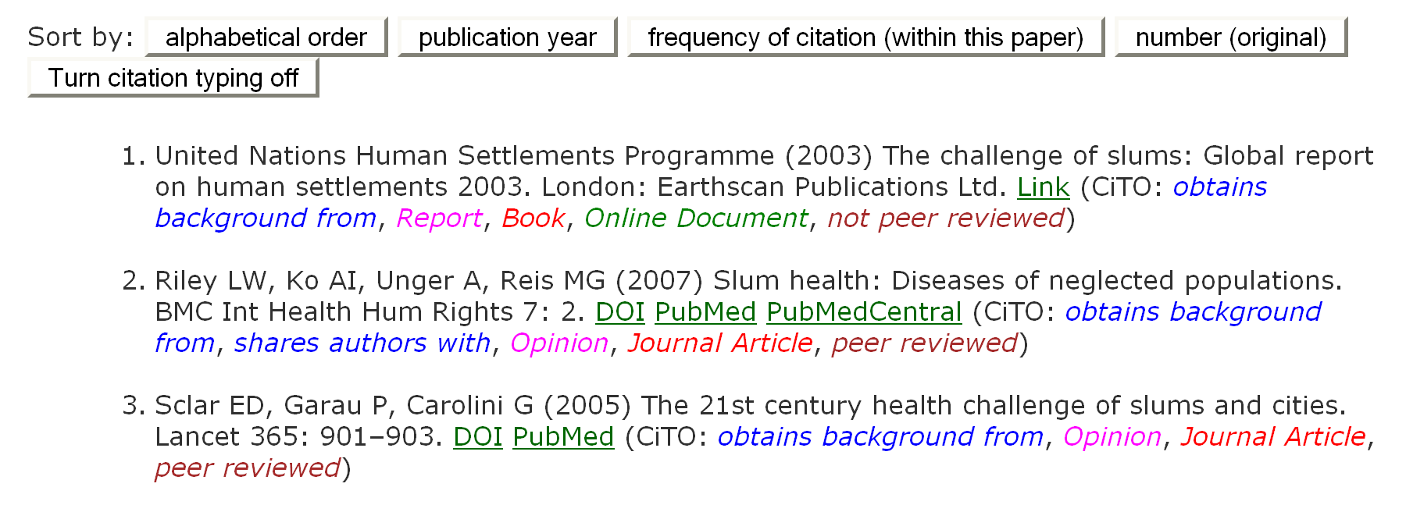
The annotated reference list
The first three references from the reference list of our enhance version of Reis et al. (2008), with the citation typing display turned on
The latest version of CiTO, the Citation Typing Ontology is as http://purl.org/spar/cito/

Slide 17
Uses of CiTO, the citation typing ontology
To permit the existence of a citation between a citing work and a cited work to be recorded in RDF
<http://example1.com/citingwork> cito:cites
<http://example2.com/citedwork> .
Even this simple statement that a citation exists opens significant possibilities, for example in enabling the easy creation of citation networks simply by combining the RDF citation lists from several papers
To permit the nature of the citation between a citing work and a cited work to be characterized,
both factually
reviews, sharesAuthorsWith, usesMethodIn, etc
and rhetorically
confirms, corrects, refutes, etc
CiTO is now part of SPAR - Semantic Publishing and Referencing Ontologies, a suite of eight generic OWL 2 DL ontologies covering all scholarly publishing
Available from http://purl.org/spar/

Slide 18
Clustering of CiTO relationships by similarity
Rhetorical
Neutral
Cites
Cites as related
Discusses
Reviews
Extends
Negative
Corrects
Qualifies
Disagrees with
Disputes
Refutes
Positive
Agrees with
Confirms
Credits
Supports
Critiques
Parodies
Ridicules
Contains assertion from
Cites as authority
Cites as evidence
Obtains background from
Obtains support from
Uses data from
Uses method in
Cites as data source
Cites for information
Cites as metadata document
Cites as source document
Shares authors with
Documents
Updates
Includes excerpt from
Includes quotation from
Plagiarizes
Factual

Slide 19
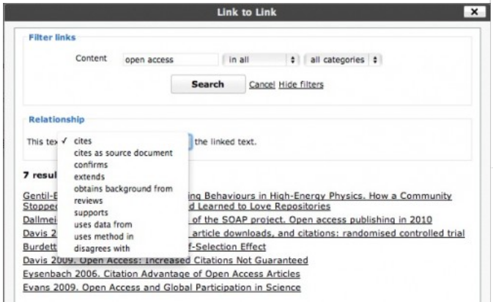
Tools that use CiTO
Egon Willighagen’s use in CiteULike
Martin Fenner’s plugin for WordPress blogs
Martin is now working with Digital Science to use CiTO within social media

Slide 20
The SPAR Ontologies

Slide 21
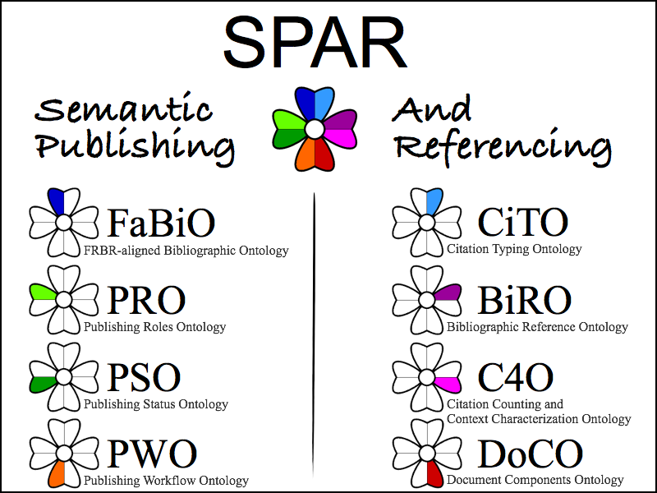
SPAR – Semantic Publishing and Referencing Ontologies
http://purl.org/spar/

Slide 22
The SPAR Ontologies
These SPAR ontologies are described at http://purl.org/spar/ and in my blog Open Citations and Semantic Publishing at http://opencitations.wordpress.com
CiTO, the Citation Typing Ontology http://purl.org/spar/cito
enable characterization of the nature or type of citations, both factually and rhetorically
FaBiO, the FRBR-aligned Bibliographic Ontology http://purl.org/spar/fabio
is an ontology for describing bibliographic entities (books, articles, etc.)
(being implemented in the ECO4R project – see previous talk)
BiRO, the Bibliographic Reference Ontology http://purl.org/spar/biro
is an ontology to define bibliographic records (as subclasses of frbr:Work) and bibliographic references (as subclasses of frbr:Expression), and their compilation into bibliographic collections and bibliographic lists, respectively
FaBiO and BiRO classes are structured according to the FRBR schema of Works, Expressions, Manifestations and Items.

Slide 23
The SPAR Ontologies, continued
C4O, the Citation Counting and Context Characterization Ontology
http://purl.org/spar/c4o allows the characterization of bibliographic citations in terms of their number (both locally and globally), and their context
DoCO, the Document Components Ontology http://purl.org/spar/doco
provides a structured vocabulary of document components, both structural (e.g. paragraph) and rhetorical (e.g. introduction)
PRO, the Publishing Roles Ontology http://purl.org/spar/pro
is an ontology for the roles of agents (e.g., author, editor, publisher, librarian) in the publication process, and the times during which those roles are held
PSO, the Publishing Status Ontology http://purl.org/spar/pso
is an ontology for the publication status of a document and other publication entity (e.g. draft, under review, published, Version of Record, catalogued)
PWO, the Publishing Workflow Ontology http://purl.org/spar/pwo
describing the steps in the workflow associated with the publication of a document or other publication entity

Slide 24
Citation information encoded in RDF using SPAR
<http://dx.doi.org/10.1371/journal.pntd.0000228> # The citing paper, Reis et al., 2008
a fabio:JournalArticle ; # expression
frbr:realizationOf [ a fabio:ResearchPaper ] ; # work
pso:holds [a pso:StatusInTime ; pso:withStatus pso:peer-reviewed ] ;
cito:cites <http://dx.doi.org/10.1016/S0140-6736(99)80012-9> ; # Reference [6]; Ko et al., 1999
frbr:part [a biro:BibliographicReference ;
biro:references <http://dx.doi.org/10.1016/S0140-6736(99)80012-9> ;
c4o:hasInTextCitationFrequency "10"^^xsd:nonNegativeInteger ] ;
cito:obtainsBackgroundFrom <http://dx.doi.org/10.1016/S0140-6736(99)80012-9> ;
cito:usesDataFrom <http://dx.doi.org/10.1016/S0140-6736(99)80012-9> ;
cito:confirms <http://dx.doi.org/10.1016/S0140-6736(99)80012-9> ;
cito:extends <http://dx.doi.org/10.1016/S0140-6736(99)80012-9> ;
cito:sharesAuthorsWith <http://dx.doi.org/10.1016/S0140-6736(99)80012-9> .
<http://dx.doi.org/10.1016/S0140-6736(99)80012-9> # Reference [6], the cited paper, Ko et al., 1999
dcterms:bibliographicCitation "Ko AI, Reis MG, Ribeiro Dourado CM, Johnson WD Jr, Riley LW (1999). Urban epidemic of severe leptospirosis in Brazil. Salvador Leptospirosis Study Group. Lancet 354: 820-825.";
prism:publicationDate "1999-09-04"^^xsd:date ;
cito:isCitedBy <http://dx.doi.org/10.1371/journal.pntd.0000228> ;
c4o:hasGlobalCitationFrequency [ a c4o:GlobalCitationCount ;
c4o:hasGlobalCountValue ”309"^^xsd:integer ; c4o:hasGlobalCountDate "2011-09-07"^^xsd:date ;
c4o:hasGlobalCountSource <http://scholar.google.com> ] .

Slide 25
Metadata for describing bibliographic entities – next steps
The National Library of Medicine DTD has become the de facto standard for many publishers, who use it to create XML mark-up for journal articles
but usually fail to publish that markup for the benefit of users!
In collaboration with Deborah Lapeyre of Mulberry, who created it, we plan to map to RDF the Journal Article Tag Suite (the NISO-standard next version of the National Library of Medicine DTD), using Dublin Core, PRISM, FRBR, SPAR and other appropriate ontologies, and to publish this mapping as open data

Slide 26
Citation contexts

Slide 27
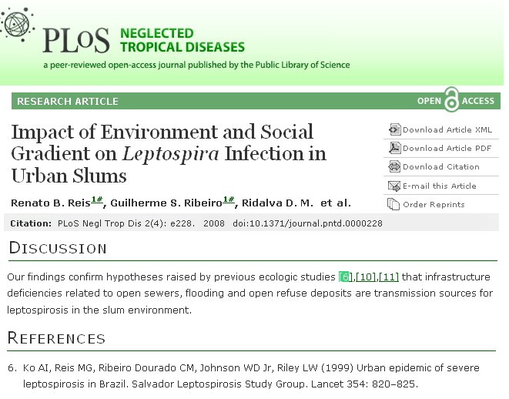
Nomenclature
“a reference”
Typical lazy use of the word “reference”
“a reference”
“a reference”
“a reference”

Slide 28
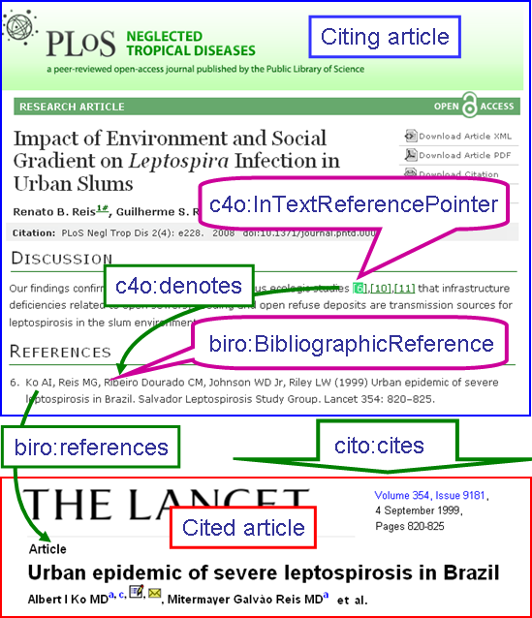
Nomenclature
Nomenclature adopted by our SPAR (Semantic Publishing and Referencing) Ontologies that include CiTO, the Citation Typing Ontology
http://purl.org/spar/

Slide 29
How do citations work?
At some point in the text of the citing article, a citation is made to a paper [6], bibliographic details of which are given in the reference list
However, the reasons for citing that particular paper are not made explicit

Slide 30
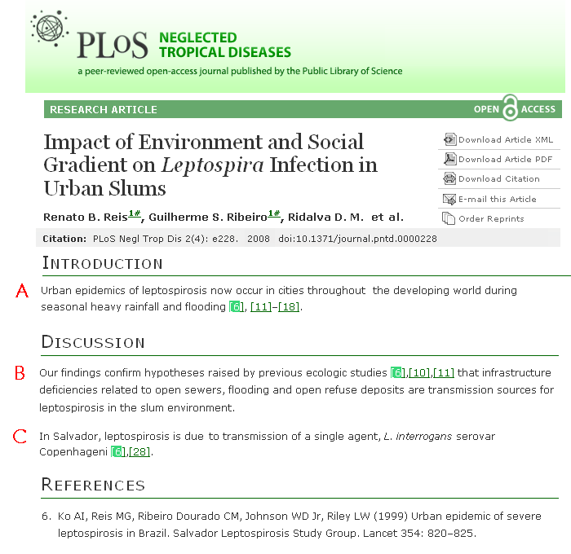
Three of the ten in-text reference pointers to Reference [6], Ko et al.
A is about rainfall and flooding
B is about the environment
C is about the infectious agent

Slide 31
Six of nine statements selected from Ko et al. most relevant to those three in-text citation pointers in Reis et al.
4, 5 and 9 are relevant to A in Reis et al.
2, 3, 7 and 9 are relevant to B
1, 6 and 8 are relevant to C
Real data !

Slide 32
The Supporting Claims Tooltip
Pulls back information relevant to the context of the citing sentence
Example one – general statement about leptosporosis and slums

Slide 33
The Supporting Claims Tooltip
Pulls back information relevant to the context of the citing sentence
Example two – specific data relating leptospirosis to rainfall and flooding

Slide 34
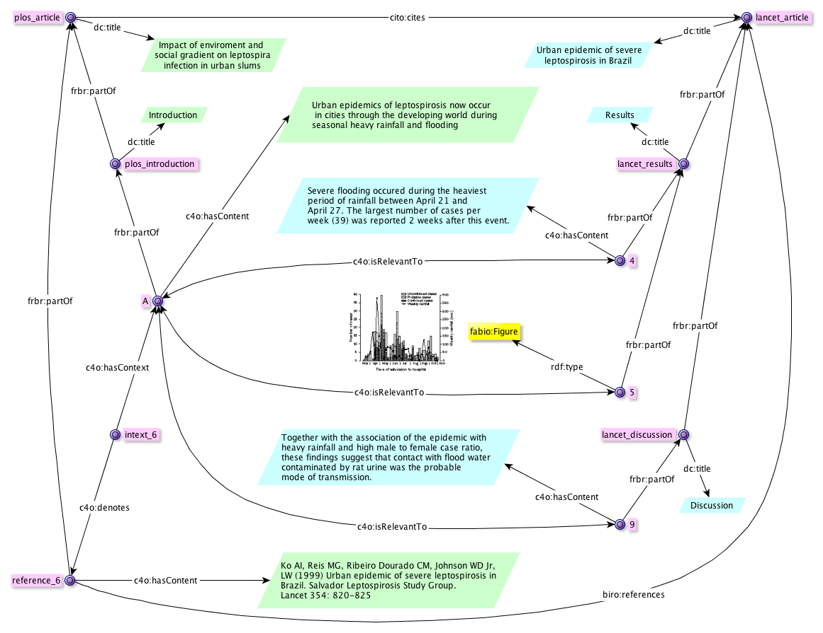
Using the SPAR Ontologies, all elements of the relationships between in-text reference pointer A in Reis et al. and relevant items 4, 5 and 9 in Ko et al. can be recorded in RDF
Citation Referencing Relevance

Slide 35
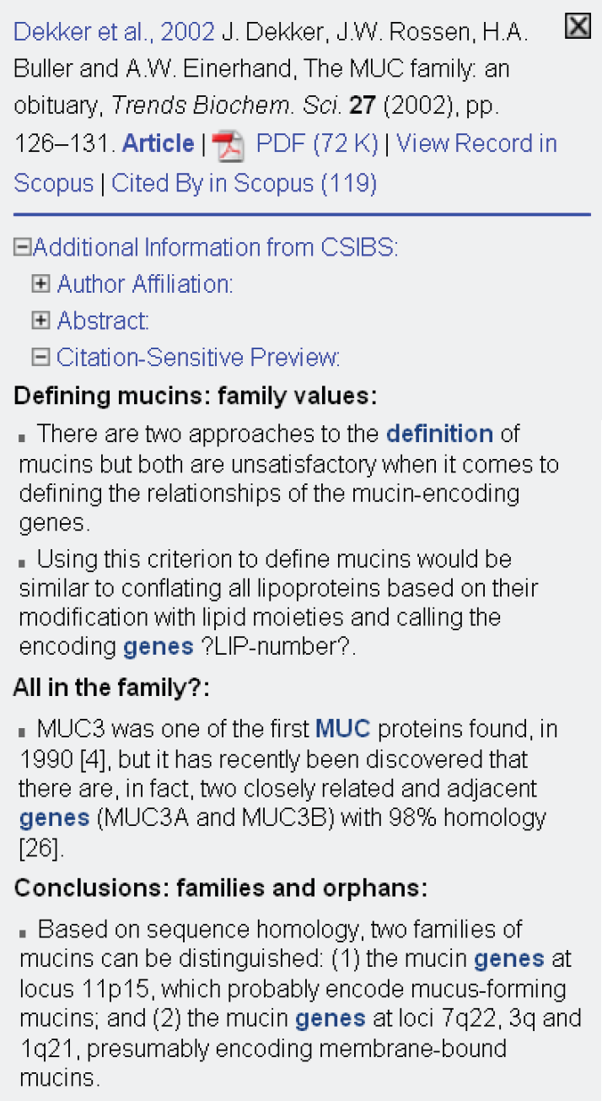
Automating citations in context
Work of Stephen Wan, CSIRO
Finalist in the Elsevier Grand Challenge
Used text mining system over the Elsevier life science corpus to automate the creation of ‘citations in context’
By clicking on the in-text citation of Dekker et al. 2002 in a citing paper, four sentences of relevance to the context of that citation are pulled back from the cited paper
Now doing this over the Open Access Subset of PubMed Central

Slide 36
The Open Citations Corpus

Slide 37
The JISC Open Citations Project - publishing bibliographic and data citations as Linked Open Data
The problem
Citation data are hard to find, locked in the reference lists of copyright articles
Scope, vision and aim of the Open Citation Project
The Open Citations Project is global in scope, designed to change the face of scientific publishing and scholarly communication
Its vision is to publish citation data openly as Linked Open Data
It aims to make citation links as easy to traverse as Web links
Potential benefits of Open Citations
Cited works are more easily discovered
Citation networks can be explored to study the growth of knowledge
The most cited papers – nodes with high degree (Barabási) – clearly exposed
Distortions in knowledge caused by mis-citation can be identified

Slide 38
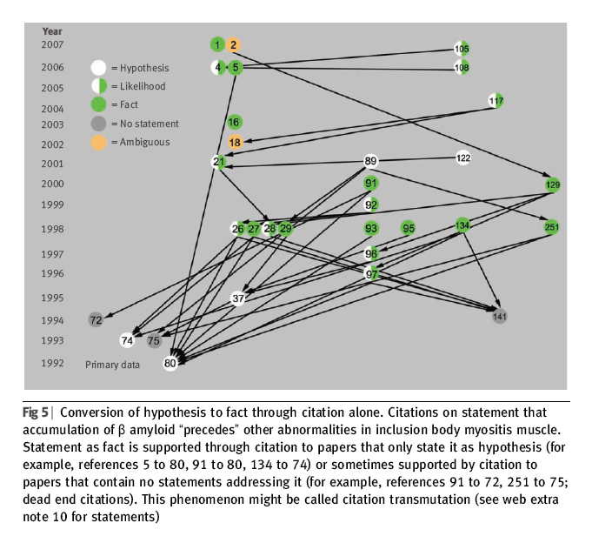
Conversion of hypothesis to ‘fact’ by citation alone
Citation:
Steven Greenberg (2009).
How citation distortions create unfounded authority: analysis of a citation network.
British Medical Journal 339: b2608.

Slide 39
The Open Citations Corpus
The reference lists from all 204,637 articles in the Open Access Subset of PubMed Central (as of 24 January 2011), each encoded as a Named Graph
These reference lists contain 6,325,178 individual references, some unique, but many from different citing articles to the same highly cited papers
These refer to 3,373,961 unique papers outside the Open Access Subset
~ 20% of all PubMed papers published between 1950 and 2010
includes ALL the highly cited papers in every biomedical field
Encoded these bibliographic records and the citations between them in RDF, creating ~236 million quads occupying 2.1 gigabytes of compressed storage
Freely available under a CC0 waiver from http://opencitations.net/data/
Accessible via the Web site or a SPARQL endpoint

Slide 40
Viewing citation networks at http://opencitations.net

Slide 41
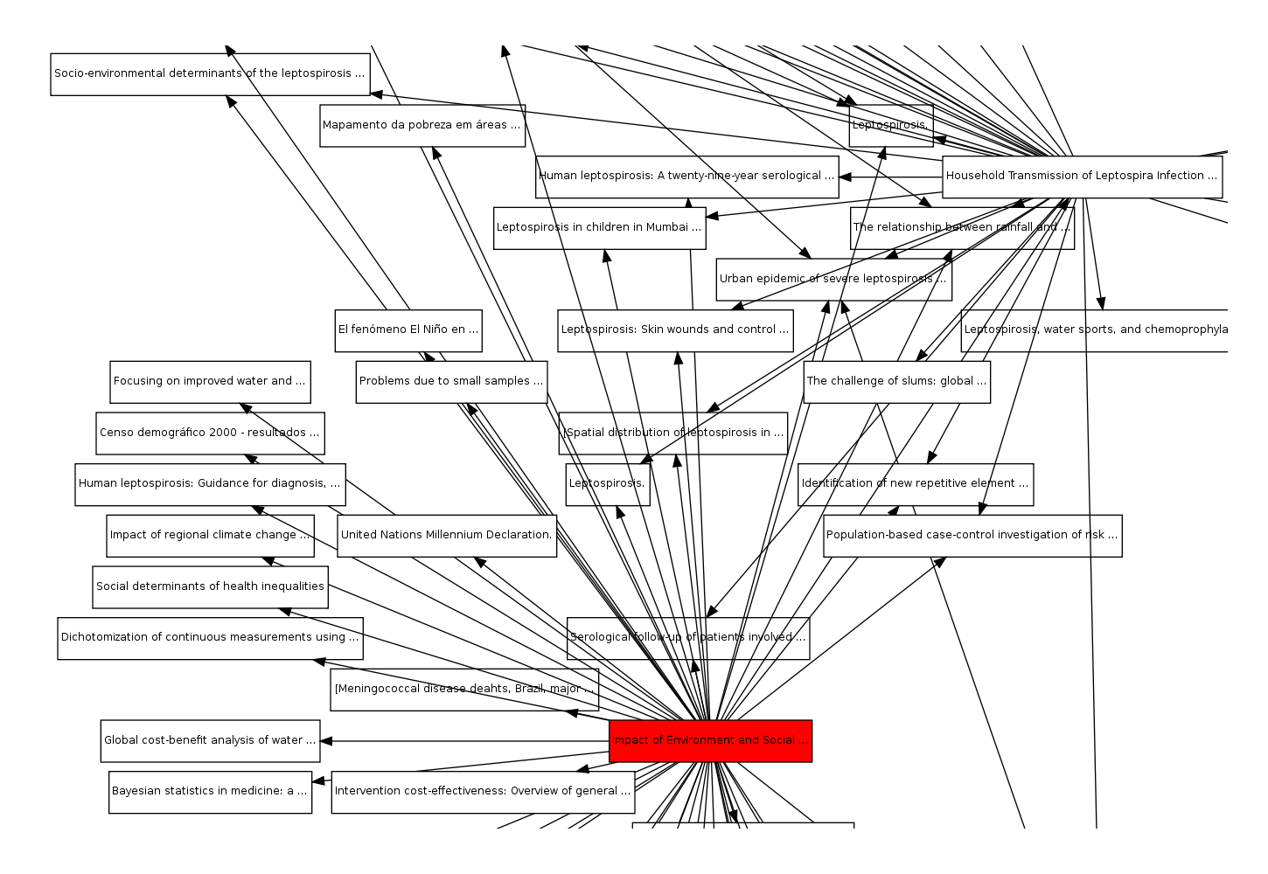
The outward citation network of Reis et al. (2008)

Slide 42
The Open Citation Corpus is a work in progress
Details of how the corpus was produced, and how errors in references were corrected, can be found in my Open Citations blog http://opencitations.workpress.com
We still have some tidying up to do, particularly for citation network display
We are not content with the reference lists from ~200,000 Open Access biomedical articles, when ~ one million new articles are published each year
We are thus in discussion with those who have their hands on substantial volumes of reference data, who may be able to persuade publishers that articles’ reference lists, like the articles’ own bibliographic data, should be open
In an ideal world, journals’ reference data would be published as Open Linked Data at SPARQL endpoints maintained by each publisher
However, since there are also benefits to having the whole corpus in one place, we are also negotiating a permanent hosting environment for the corpus
We welcome interest from anyone who has journal reference data they wish to contribute to the Open Citation Corpus

Slide 43
Using the citation data - Open Research Reports
Top Papers for Open Research Reports
 | Number of papers cited | Pubmed IDs of 20 most highly cited papers (with number of times cited)
Disease name |  | 1 |  | 2 |  |  |  | 3 |  |  | 4
Cholera | 1,993 | 10952301 | 47 | 15242645 |  | 44 |  | 2836362 |  | 25 | 16432199 |  | 24
Dengue fever | 3,858 | 17510324 | 44 | 9665979 |  | 42 |  | 1372617 |  | 34 | 15577938 |  | 32
HIV/AIDS | 54,432 | 9516219 | 122 | 12167863 |  | 101 |  | 9539414 |  | 86 | 12742798 |  | 83
Leprosy | 1,147 | 11234002 | 70 | 17604718 |  | 18 |  | 15894530 |  | 13 | 12901893 |  | 12
Leptospirosis | 940 | 11292640 | 47 | 14652202 |  | 37 |  | 12712204 |  | 27 | 15028702 |  | 26
Malaria | 25,290 | 12368864 | 230 | 12364791 |  | 146 |  | 781840 |  | 134 | 12893887 |  | 101
Measles | 1,719 | 11742391 | 22 | 16262740 |  | 19 |  | 15798843 |  | 18 | 8974392 |  | 13
Pneumonia | 6,901 | 8995086 | 60 | 15699079 |  | 53 |  | 11463916 |  | 49 | 10524952 |  | 47
Schistosomiasis | 3,036 | 15866310 | 49 | 12973350 |  | 46 |  | 16790382 |  | 43 | 4675644 |  | 40
Trypanosomiasis | 5,864 | 16020726 | 108 | 16020725 |  | 75 |  | 10215027 |  | 57 | 43092 |  | 35
Tuberculosis | 16,091 | 9634230 | 117 | 9157152 |  | 83 |  | 12742798 |  | 83 | 8381814 |  | 80
Amyotrophic lateral sclerosis | 2,380 | 8446170 | 46 | 17023659 |  | 32 |  | 11386269 |  | 22 | 15217349 |  | 22
Spinal muscular atrophy | 555 | 7813012 | 28 | 10339583 |  | 20 |  | 11925564 |  | 20 | 9074884 |  | 15
Total exluding ALS and SMA | 121,271
Total | 124,206
Average | 9,554

Slide 44
MIIDI

Slide 45
The document summary for Reis et al. (2008)

Slide 46
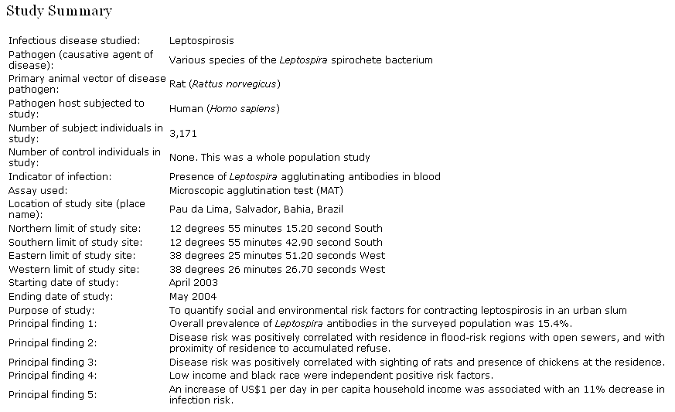
Summary information from Reis et al. 2008
Impact of Environment and Social Gradient on Leptospira Infection in Urban Slums
PLoS Neglected Tropical Diseases 2(4): e228. http://dx.doi.org/10.1371/ journal.pntd.0000228.x001
Limitations:
Hand crafted
No data model
Not in RDF

Slide 47
MIIDI http://www.miidi.org/
MIIDI is a Minimal Information standard for an Infectious Disease Investigation
I held an international MIIDI workshop in September 2009 to get an initial draft
In January 2011, Tanya Gray started work with me to develop MIIDI properly
She has now develop MIIDI into a validated XML data model, and has created a MIIDI Form that permits easy metadata entry conforming to the MIIDI standard
http://www.miidi.org:8080/input-form/
The MIIDI standard can be used not only to create structured metadata for
journal articles, but also to describe
data sets,
mathematical models,
experimental workflows and
software relevant to an infections disease investigation,
providing metadata to accompany data repository deposit

Slide 48
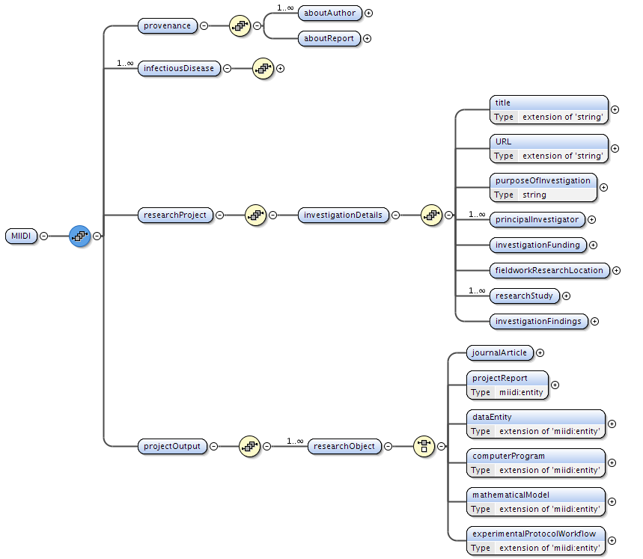
The MIIDI XML data model

Slide 49
Open Research Reports

Slide 50
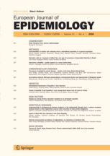
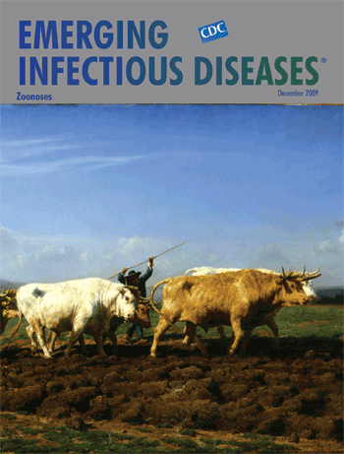
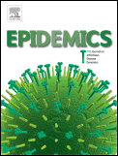
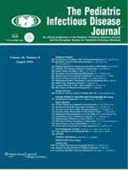
How do we get from here . . .
EJE Euro 1455

Slide 51
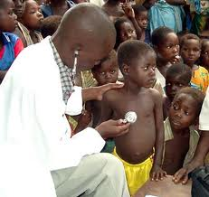
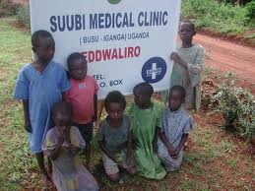
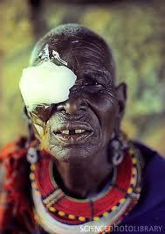
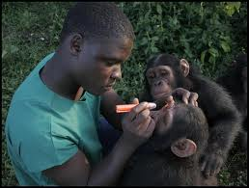
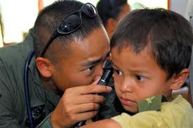
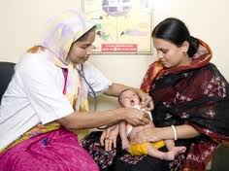
. . . to here?

Slide 52
The problem of access to the biomedical literature
The free access to biomedical journals in developing countries offered by the HINARI Programme, set up in 2002 by WHO together with major publishers, is at risk
The Lancet Editorial, 22 January 2011:
DOI:10.1016/S0140-6736(11)60066-4
“When news came last week that several large publishers—including Elsevier (our publisher), Lippincott Williams & Wilkins, and Springer—had withdrawn journals from HINARI’s Bangladesh programme (and other countries too, such as Kenya and Nigeria), there was a collective cry of betrayal.”
“Elsevier says that Bangladesh is a country that could move to a ‘discounted commercial agreement’, and that there will be other countries too.”
“Our view is that any country designated as “low human development” by the UN justifies a clear and unambiguous commitment by all publishers to full and free access to research results through HINARI.“

Slide 53
Our vision: Open Research Reports
The pre-existing ideas
of a structured digital abstract to encapsulate the basic facts in an infectious disease article,
of the MIIDI metadata standard to guide its encoding,
and of the most cited disease papers from the Open Citations Corpus
led to the first vision for Open Research Reports in January 2011, following a discussion with Leslie Chan, Cameron Neylon and Peter Murray Rust
1 To get experts to create Open Research Reports for papers they read
employing a tool they find easy to use, based on MIIDI, in a way that creates annotations that are also useful for their own personal use
2 To publish these reports in a set of subscription-free open access journals using Annotum
e.g. Open Research Reports in Malaria, . . . in HIV, . . . in Tuberculosis
bringing the authors academic credit for a citable mini-publication
3 To tackle first the 100 most cited papers for the major infectious diseases

Slide 54
‘Disease’ section of the MIIDI Report for Reis et al. 2008

Slide 55
‘Output’ section of the MIIDI Report for Reis et al. 2008

Slide 56
What next for Open Research Reports?
Semantic Web Applications and Tools for Life Sciences Hackathon
http://www.ukoln.ac.uk/events/devcsi/life-sciences-hackdays/programme/index.html
A two day event hacking content, systems and services for the Life Sciences, with a focus on Open Research Reports
University of London Union, Malet Street, London, WC1E 7HY
Tuesday 6th December and Wednesday 7th December, 2011
Fund raising / grant applications (Wellcome? Gates?) to enable further development
Gathering like-minded collaborators to work together
If YOU would like to participate, please let me know!

Slide 57
. . . with acknowledgement of the excellent work of my IBRG colleagues Semantic publishing Katie Portwin, Alistair Miles and Graham Klyne SPAR ontologies Silvio Peroni Open Citations Ben O’Steen and Alex Dutton MIIDI Tanya Gray and with thanks to the JISC for funding over recent years
end
Notes:
I have illustrated tools and systems we have been working on that facilitate managing, publishing, describing and citing data. These are all open source, and freely available for use.
In particular, I would encourage Pro-Vice Chancellors for Research, IT managers and similar institutional decision-makers to contact me if you would like to explore the use of DataStage for your research groups’ local data management requirements, and DataBank as a solution to your institutional data repository requirements.

Slide 58
FaBiO and BiBO, the Bibliographic Ontology
BiBO is a good ontology, written in OWL, and widely used.
However, FaBiO and BiBO differ in several significant aspects:
BiBO is ‘flat’, lacking the FRBR structure, thus lacking expressiveness
BiBO is less complete (69 classes, as opposed to 211 in FaBiO)
For example, BiBO lacks classes for Blog Post, Computer Program, Dataset, Grant Application, Supplementary File, and Thesaurus
FaBiO is complemented by the other SPAR ontologies to form a complete ontological environment for publication entities:
CiTO to describe citations, BiRO to describe bibliographic records, reference lists, library catalogues, etc., DoCO to describe document components, and so on.
The differences are described more fully at http://bit.ly/qhVtpC
We have prepared an RDF mapping document, BIBO2SPAR, that maps BiBO to FaBiO using SKOS, as described at http://bit.ly/rwf1t6

Slide 59
Open Research Reports and copyright
The idea of Open Research Reports is to free data trapped in journal articles to which subscription access barriers exist, and to publish them
in an open access ‘instant’ journal such as PLoS Currents
in machine-readable RDF as Open Linked Data
How is this possible, if the article itself is covered by copyright?
Under US law, bare facts cannot be copyrighted
Quotation of brief excerpts from a copyrighted article for the purpose of comment or review is permissible under ‘fair usage’ laws
A scholar’s personal annotations about a copyright journal article are hers to publish as she wishes, and are free from the copyright restrictions pertaining to the original article

Slide 60
Citing datasets

Slide 61
Metadata for describing datasets
The DataCite mandatory metadata properties required for DOI assignment:
Creator (i.e. authors)
Publication Year
Title
Publisher (i.e. repository name “Dryad Data Repository”)
Identifier (the DOI)
We have mapped the DataCite metadata kernel to RDF
See http://opencitations.wordpress.com/
We have created CiTO4Data and the DataCite Ontology, two small ontologies to add terms required for describing datasets but not bibliographic entities
http://purl.org/spar/cito4data/
We wish to provide tools that facilitate the creation of richer metadata to assist in resource discovery and description
The particular focus for our enhanced metadata is infectious disease data

Slide 62
Mapping DataCite metadata elements to RDF
With Silvio Peroni, I have mapped the DataCite Metadata Kernel v2.0 to RDF
see DataCite2RDF at http://bit.ly/jG0wt1, and my blog post at http://opencitations.wordpress.com/2011/06/30/datacite2rdf-mapping-datacite-metadata-scheme-terms-to-ontologies-2/
This has been done using elements from
Dublin Core, FOAF, PRISM and FRBR, and from the SPAR (Semantic Publishing and Referencing) Ontologies (http://purl.org/spar/)
CiTO, Citation Typing Ontology
CiTO4Data, an extension of CiTO for datasets
FaBiO, the FRBR-aligned Bibliographic Ontology
and from a new DataCite Ontology (http://purl.org/spar/datacite/)
We then used these to map to RDF
the DataCite XML example, and
the metadata for a Dryad repository holding,
showing use of DataCite2RDF for real data

Slide 63
We need better methods of citing data
At present, published datasets are poorly cited in the scientific literature
A survey of PLoS journal articles related to Dryad datasets showed that
most papers lacked any reference to Dryad,
the others only have unstructured citations within the body text, e.g.
“A selection of the 30,000 structures is represented in Fig. 1 and a repository, with their all-atom configuration, is available at http://dx.doi.org/10.5061/dryad.1922.”
“Raw microsatellite data generated in this study have been deposited in the Dryad database (http://www.datadryad.org) under accession number 1540.”
“Initiatives such as Dryad (http://datadryad.org/repo) (where the data in this study are published) should mean that literature data become easier to gather and maintain in the future.”
None of the papers had a proper data reference in its reference list

Slide 64
Best practice for the citation of datasets
I have proposed best practice for citing datasets, available in a discussion paper at http://bit.ly/lt7VsM, recommending:
That the citation style for referencing on-line data should be as similar as possible to that used for referencing scholarly articles
Creator (PublicationYear) Title. Publisher. Identifier.
That the preferred data identifier to be used is a Digital Object Identifier or, if that is not available, the unique accession number or identifier used by the data repository or database in which the data resides
That this reference be included in the paper’s reference list
That this data reference in the reference list should be denoted by an appropriate in-text citation, including an in-text reference pointer

Slide 65
Example of best practice for the citation of a Dryad dataset
Example in-text citation and in-text reference pointer: "The raw data underpinning this analysis are deposited in the Dryad Data Repository at http://dx.doi.org/10.5061/dryad.8684 (Vijendravarma et al., 2011)."
Example data reference in the article’s reference list: Vijendravarma RK, Narasimha S, Kawecki TJ (2011). Data from: Plastic and evolutionary responses of cell size and number to larval malnutrition in Drosophila melanogaster. Dryad Digital Repository. doi:10.5061/dryad.8684.”
- - - - - - - -
These recommendations have been adopted in the Data Publishing Policies and Guidelines for Biodiversity Data of the publisher Pensoft Journals, available at
http://www.pensoft.net/J_FILES/
Pensoft_Data_Publishing_Policies_and_Guidelines.pdf

Slide 66
Semantic Web basics
Information is structured using RDF, the Resource Description Framework
RDF statements are triples: subject predicate object . , forming a factual ‘sentence’
<http://dx.doi.org/10.1371/journal.pntd.0000228> rdf:type fabio:JournalArticle .
<http://dx.doi.org/10.1016/S0140-6736> prism:publicationDate "1999-09-04"^^xsd:date .
Each item is either a literal (which may have a data type), or is a <URI>
Prefixes are used to abbreviate URIs
@prefix rdf: <http://www.w3.org/1999/02/22-rdf-syntax-ns#> .
@prefix fabio: <http://purl.org/spar/fabio/> .
@prefix prism: <http://prismstandard.org/namespaces/basic/2.0/> .
@prefix xsd: <http://www.w3.org/2001/XMLSchema#> .
A collection of RDF triples about related concepts forms an RDF graph
This may be serialized as RDF/XML or in other formats, e.g. turtle
Classes and properties are defined in ontologies, providing universal meaning
Because of this, separate RDF graphs may be combined without loss of meaning, to create a Web of Linked Data

