Slide 1
culturegraph.org Aufbau eines Hubs für Linked Library Data
1
Markus M. Geipel <m.geipel@dnb.de> Adrian Pohl <pohl@hbz-nrw.de>

Slide 2
Table of Contents
2
The Linked Data Challenge
Culturegraph Platform
Resolving & Lookup
Process & Technology
RDF Modelling
Current State

Slide 3
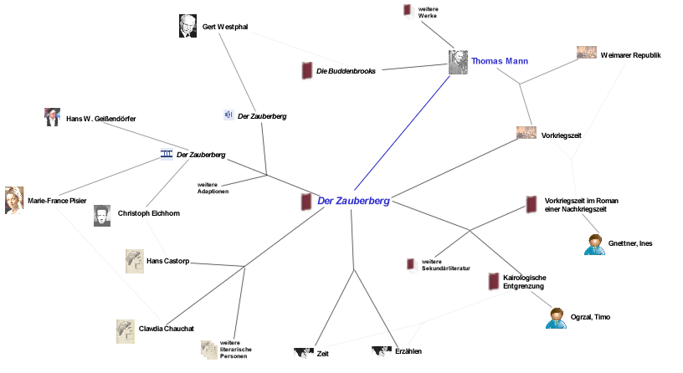
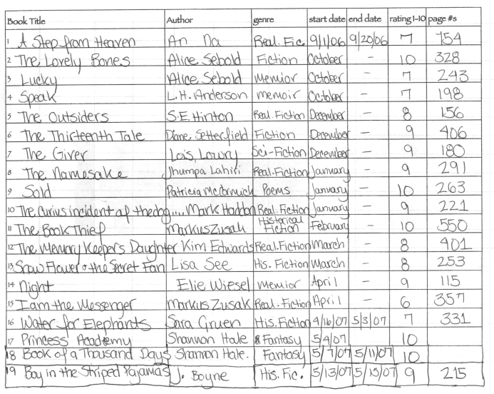
Paradigm shift in modeling knowledge/data
3
Isolated Tables
Network beyond organizational boundaries

Slide 4
From isolated Tables to a Semantic Network
4
A naïve Approach
Transform from Marc21/Mab2/Pica to RDF
Put everything into a Triplestore
SPARQL and Reasoner do the magic
What is wrong with this approach?

Slide 5
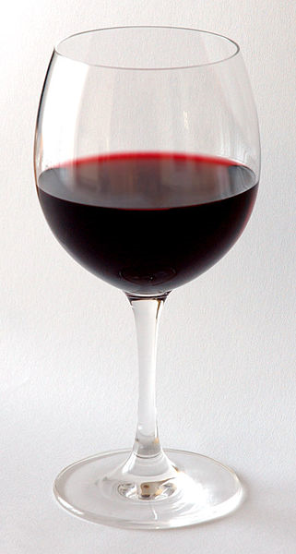
Format is not Content!
5
If you pour water into a wine-glass does it change to wine?
How can you expect old Marc21 data to change into a semantically rich, reasoner-ready piece of information just by changing the data format to RDF?
?

Slide 6
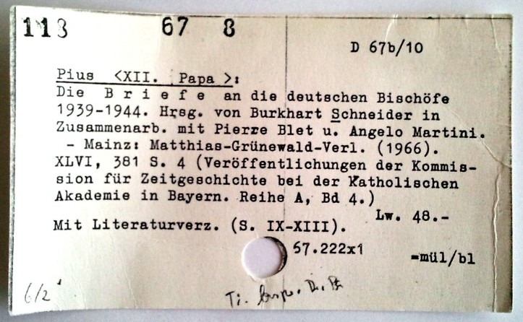
Connections don’t come for free Some challenges …
6
No universally unique id
Often no references to entities, just character-strings
No controlled vocabulary
Example: 1.3 Mio. different values for the edition field
Changing Cataloging Practices
Mistakes, Typos

Slide 7
Culturegraph as a signpost A coherent picture on bibliographic data
7
Culturegraph
?
Different services
!
Different interfaces
Hidden duplicates

Slide 8
Culturegraph as a Platform to interlink Bibliographic Data
8
Open Tools
Open algorithms and code; reuse
Integration into existing Workflows
Synchronization of data
Integration of results into original data sources
Publication Results
Connections and views, not the entire aggregated Data
Linked Open Data/RDF
Persistence of Results
Integration into URN resolving infrastructure
Tracking provenance

Slide 9
First Project: Resolving & Lookup Universally Unique and Persistent IDs
9
Input: 6 main German bibliographic catalogues
Objective: Bundling of manifestations
Service:
Publication of bundles
Minting of URNs for approved bundles
Search bundles using established identifiers
Part of the DDB Eco-System
Support for Data Aggregation

Slide 10
The Process
10
Translate into internal format
Mapping of Fields to Properties
Normalization, Cleaning, Regexp Matching, etc. defined in XML
Database ingest > 80 Million Records > One Billion Properties
XML

Slide 11
The Process
11
Generate unique properties > 50 Mio.*
Combinations of Properties defined in XML
Group by Unique Properties
Merge equivalent Groups ca. 18 Mio. Records* in groups
XML
* For a first simple Matching Algorithm

Slide 12
The Process (next steps)
12
Check quality & mint persistent Ids
Publication as Linked Data
Id1 Id2 Id3
http://

Slide 13
Representing bundles of bibliographic records in RDF
13
Notes:
13

Slide 14
Namespaces for Internal Bibliographic Description
rdf: <http://www.w3.org/1999/02/22-rdf-syntax-ns#>
bibo: <http://purl.org/ontology/bibo/>
dcterms: <http://purl.org/dc/terms/>
frbr: <http://purl.org/vocab/frbr/core#>
foaf: <http://xmlns.com/foaf/0.1/>
cg: < http://culturegraph.org/vocab#> (not established yet)
...& others
14
Notes:
14
14

Slide 15
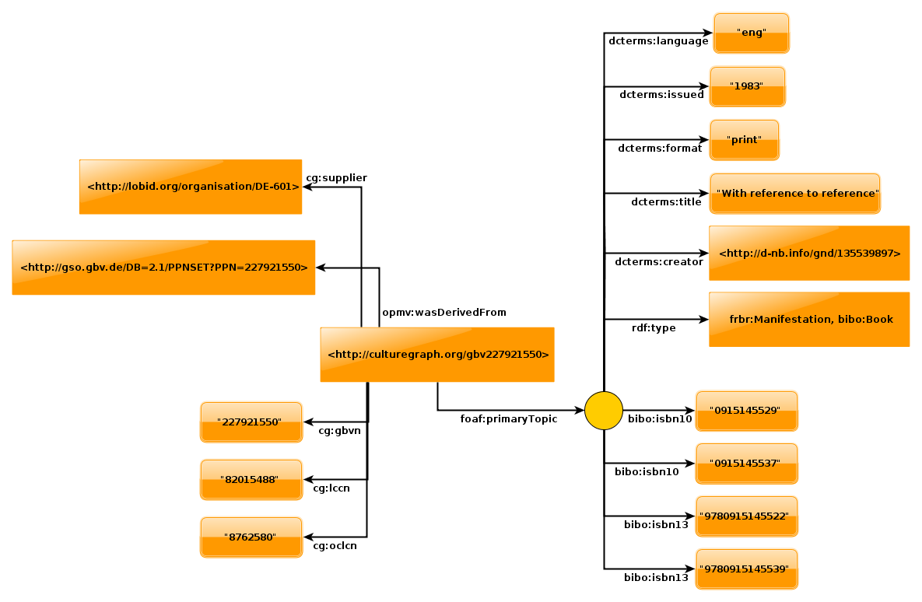
15

Slide 16
Matching & Bundling
Different matching critieria to be discussed
Example: sameness of ISBN & year
Matching algorithms can be created and modified easily
Matched resources are bundled and underlying algorithm indicated
Bundle Ontology: http://purl.org/net/bundle
16
Notes:
16
RIF erwähnen: Rule Interchange Format
16

Slide 17
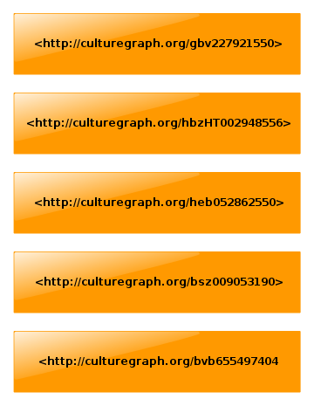
17

Slide 18
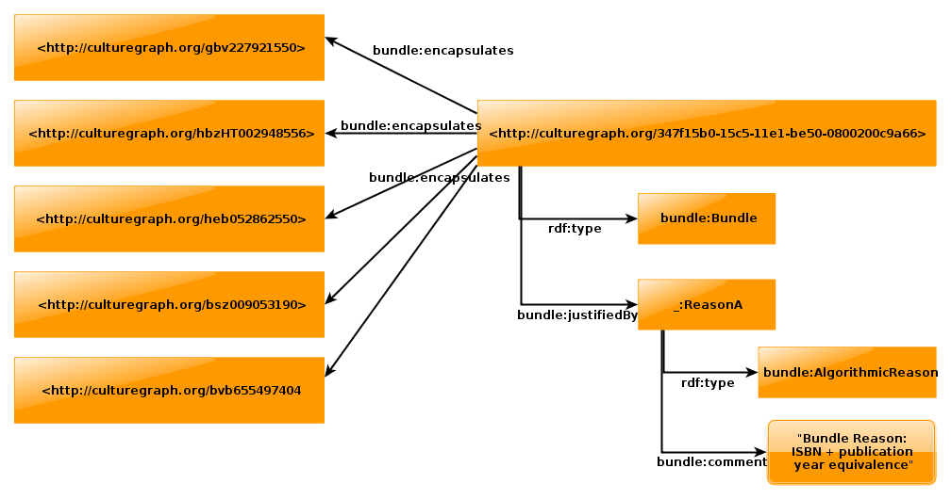
18

Slide 19
Minting Über-Identifiers
In the last step IDs for bibliographic resources may be minted
urn:nbn:de:cg-12345678
http://culturegraph.org/urn:nbn:de:cg-12345678
Based on reliable, agreed-upon algorithm
Record-resource linking by foaf:isPrimaryTopicOf
19
Notes:
19
Based on reliable agreed-upon algorithms which match different descriptions of identical resources
19

Slide 20
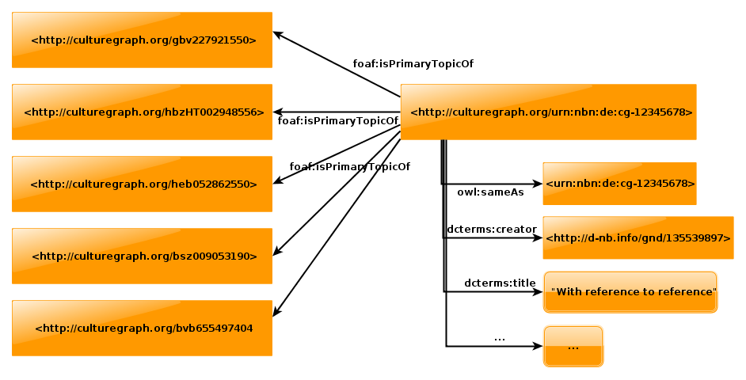
20

Slide 21
Future prospects
21
Workflow-Integration Share, enrich and reuse metadata right from the start
New Features/Projects From concrete to visionary…
Integration of GND-references (from BEACON-Files and other sources)
Computation of links to further resources (Subject Headings, Geo coordinates, Person names, Wikipedia)
Authority file for works
Crowdsourcing (enrich and correct descriptions of titles, works, persons, etc.)

Slide 22
Summary
22
Culturegraph will
Match the main German library catalogues
give each bibliographic resource a persistent ID
State
Basic infrastructure up running with good performance (80 Mio. Records Matched in one hour)
All Source Code published on Sourceforge
First Demonstrator Webportal at www.culturegraph.org
Soon to come
January:
Operational Webportal
Publication of first matching results (HTML, RDF, etc.)
Next Year:
Persistent IDs

Slide 23
Appendix: Projektmitarbeiter
23
Daniel Schäfer (DNB) Projektleitung
Katja Mecklinger (DNB) Stellvertretende Projektleitung, ÖA
Markus Geipel (DNB) Leiter Architektur und Entwicklung
Adrian Pohl (hbz) – ÖA, Ontologie
Pascal Christoph (hbz) – Architektur
Julia Hauser (DNB) - Ontologie
Lars Svensson (DNB) - Ontologie
Jürgen Kett (DNB) – Projektsteuerung, ÖA

